Slide 1
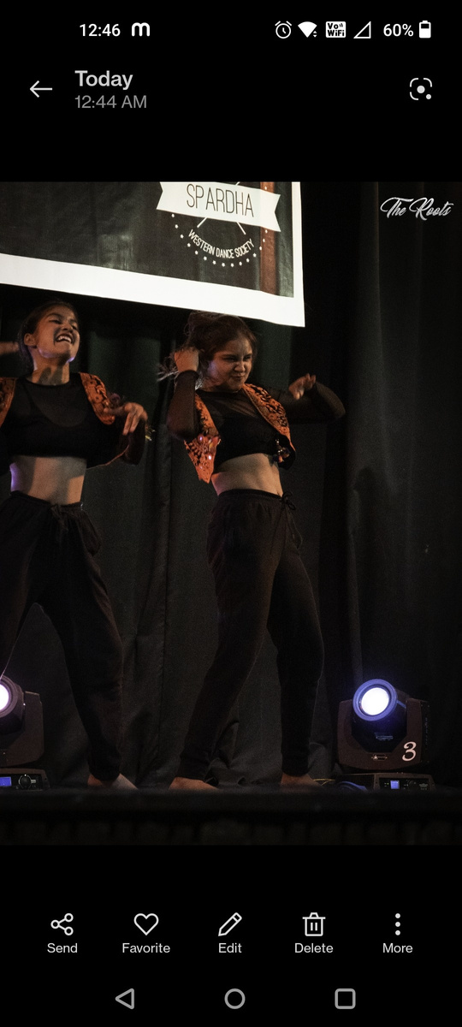
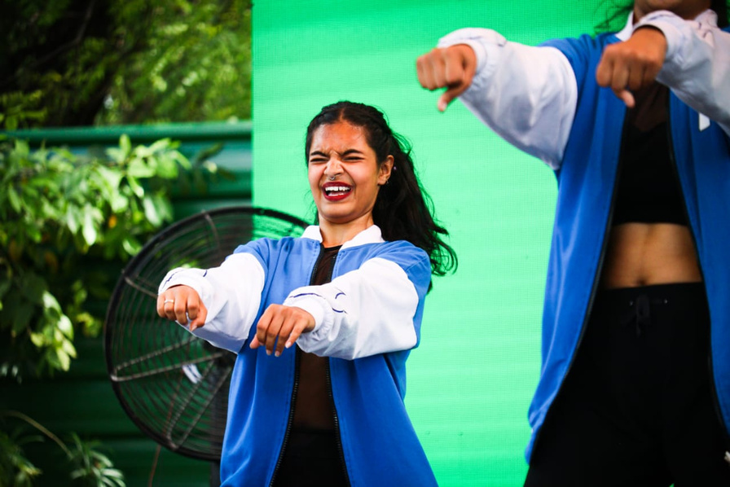
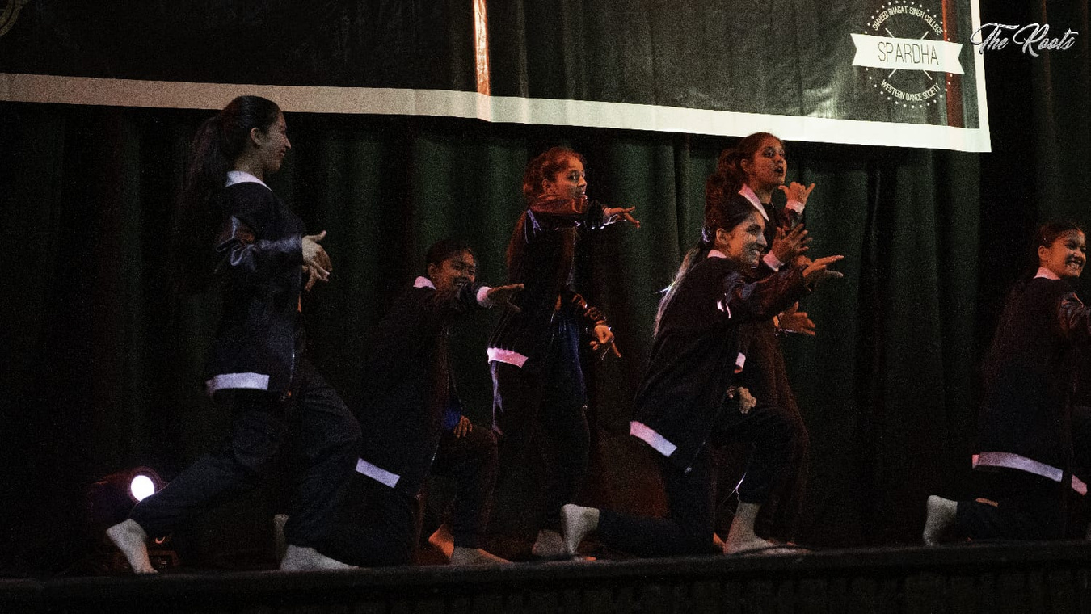
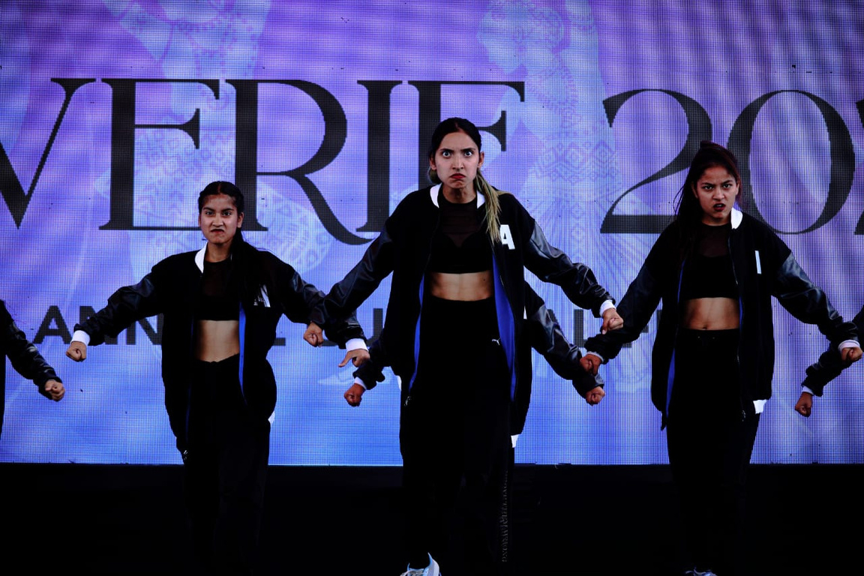
Western Dance Society
ADVAITA
Shine feel kill

Slide 2
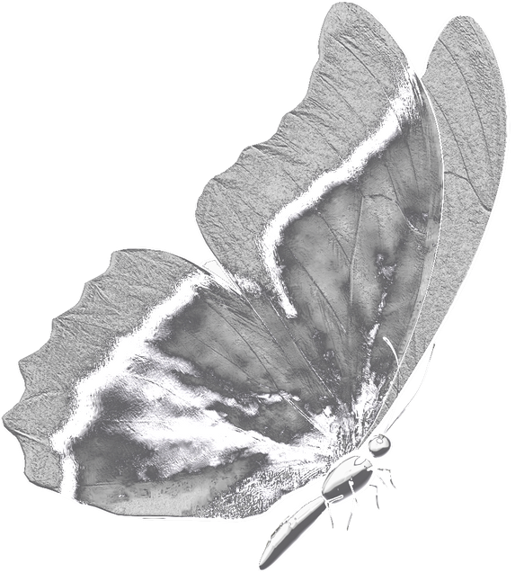
INTRODUCTION
Advaita is the western dance society of bharati college, it has been in workings since 2012, we have been focusing on all the western dance styles and have been a part of DDC ( Delhi Dance Circuit)

Slide 3
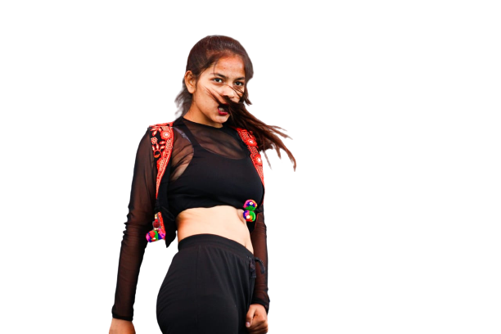
VISION
Dancing with the feet is one thing but dancing with the heart is another and at advaita we believe in doing just that. We believe in engaging the dancer not only in technique based training but also finer nuances like expressing and breathing from the soul and inspiring them through the medium of dance

Slide 4
PERFORMANCES 22-23
  DYAL SINGH COLLEGE
  • Gargi College
  • Acharaya Narendra Dev College
  • BVIMR College
  • Agrasen College
  • IIT Delhi
  • Rev Up Dance Championship

Slide 5
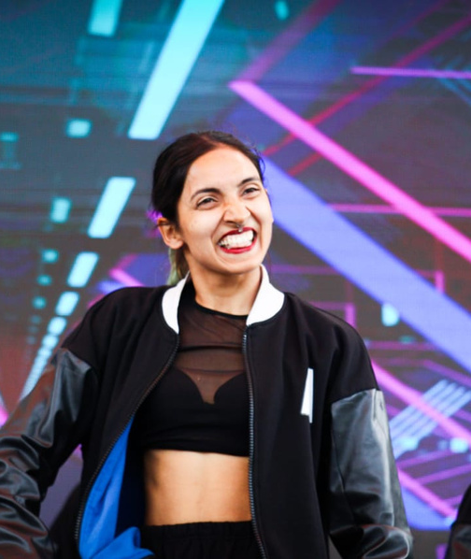
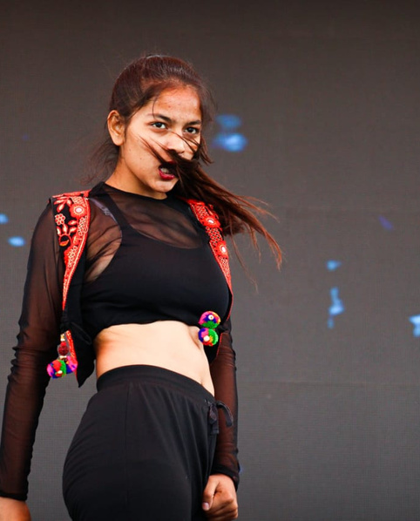
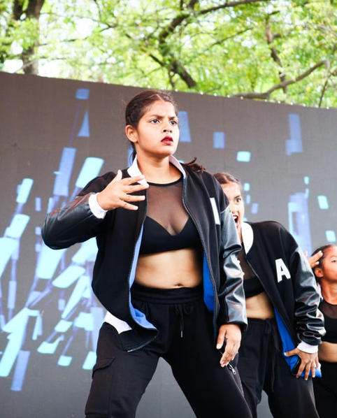
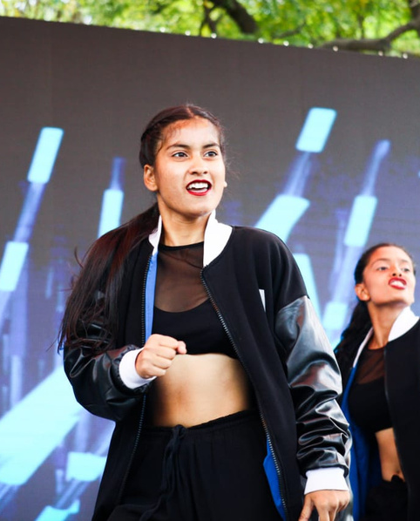
CORE TEAM
PR HEAD
JYOTI BADAK
PRESIDENT
CHITRALEKHA
VICE PRESIDENT
AKSHRA
TRESURAR
RUBY

Slide 6
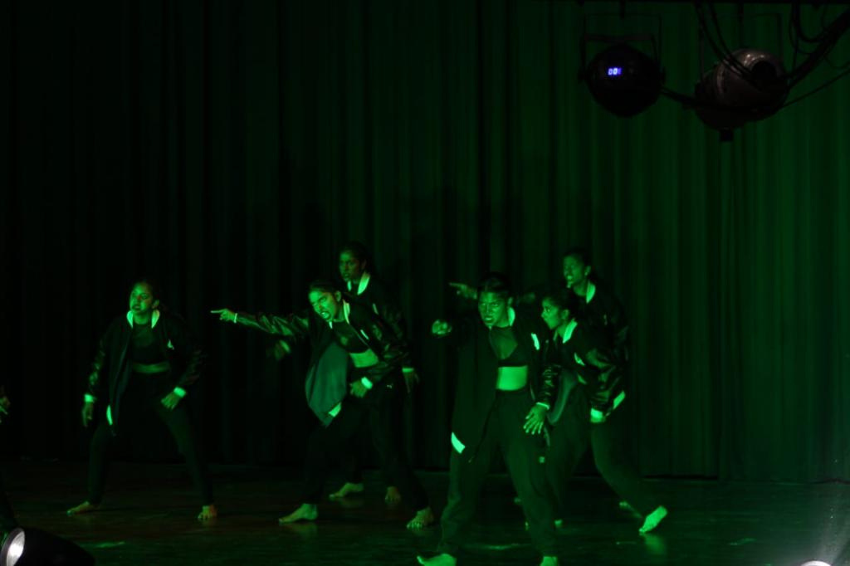
FUTURE AGENDA
ADAPT
ENHANCE
PERFORM
WINNING

Slide 7
Page 15 of 15
Thank You

