Slide 1

Kudiyan di Phulkari Society
Bharati college
University of Delhi

Slide 2
Teacher In charge
Kudiyan di Phulkari Society
Convener - Dr. Shalu kaur
Co- convener-Dr. Anshu Yadav
Dr. Bhavna Shivan
Dr. Preeti Yadav

Slide 3
Kudiyan Di Phulkari
‘Phulkari’ means the shape of flowers that symbolized life. Made of two words “PHUL” and “AKARI” that means flower and shape respectively. The birth of a girl child in Punjab family is considered as auspicious. They are treated as the princess of the family and the creators of future generations. Out of love and happiness on the birth of girl child, the mother and the grandmother would start embroidering beautiful and attractive Phulkari Dupattas for her.
Therefore, Phulkari symbolizes love, birth and auspiciousness, it is an art for representation of women roles at the level of family and household.

Slide 4
Phulkari has been mentioned in the famous, Punjabi folklore of Heer Ranjha (a love tale) by waris Shah. “It’s present form and popularity goes back to 15th century, during Maharaja Ranjit Singh’s Reign”. “Phulkari” signifies an important step for a girl to become a woman, as is mentioned even in the holy book for the Sikhs “only then will you be considered an accomplished lady when you will you – self, embroider your own blouse.”
Objectives of the Society:
Infusing Punjabi culture values to the students with training in Punjabi Folk Dances like Bhangra ,Gidda, Sammi, etc folk as well as light music. In addition, the students are preparing to complete in Poetry, Painting, Declamation, Debate, Gurbani Shabad, Folk singing. Our vision is to make the society well known in the field of Art, Literature and Culture.

Slide 5
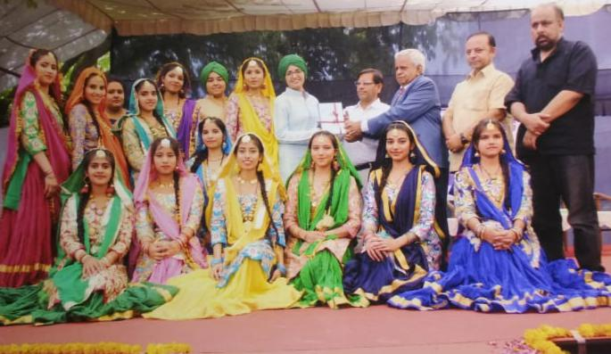
Punjabi department of college has touched new heights in the current academic session. Besides academics belonging to department have first time participated in different literary as well as cultural functions organized by different colleges of University of Delhi. Department of Punjabi launched its Punjabi cultural society ‘Kudiyan di Phulkari’

Slide 6
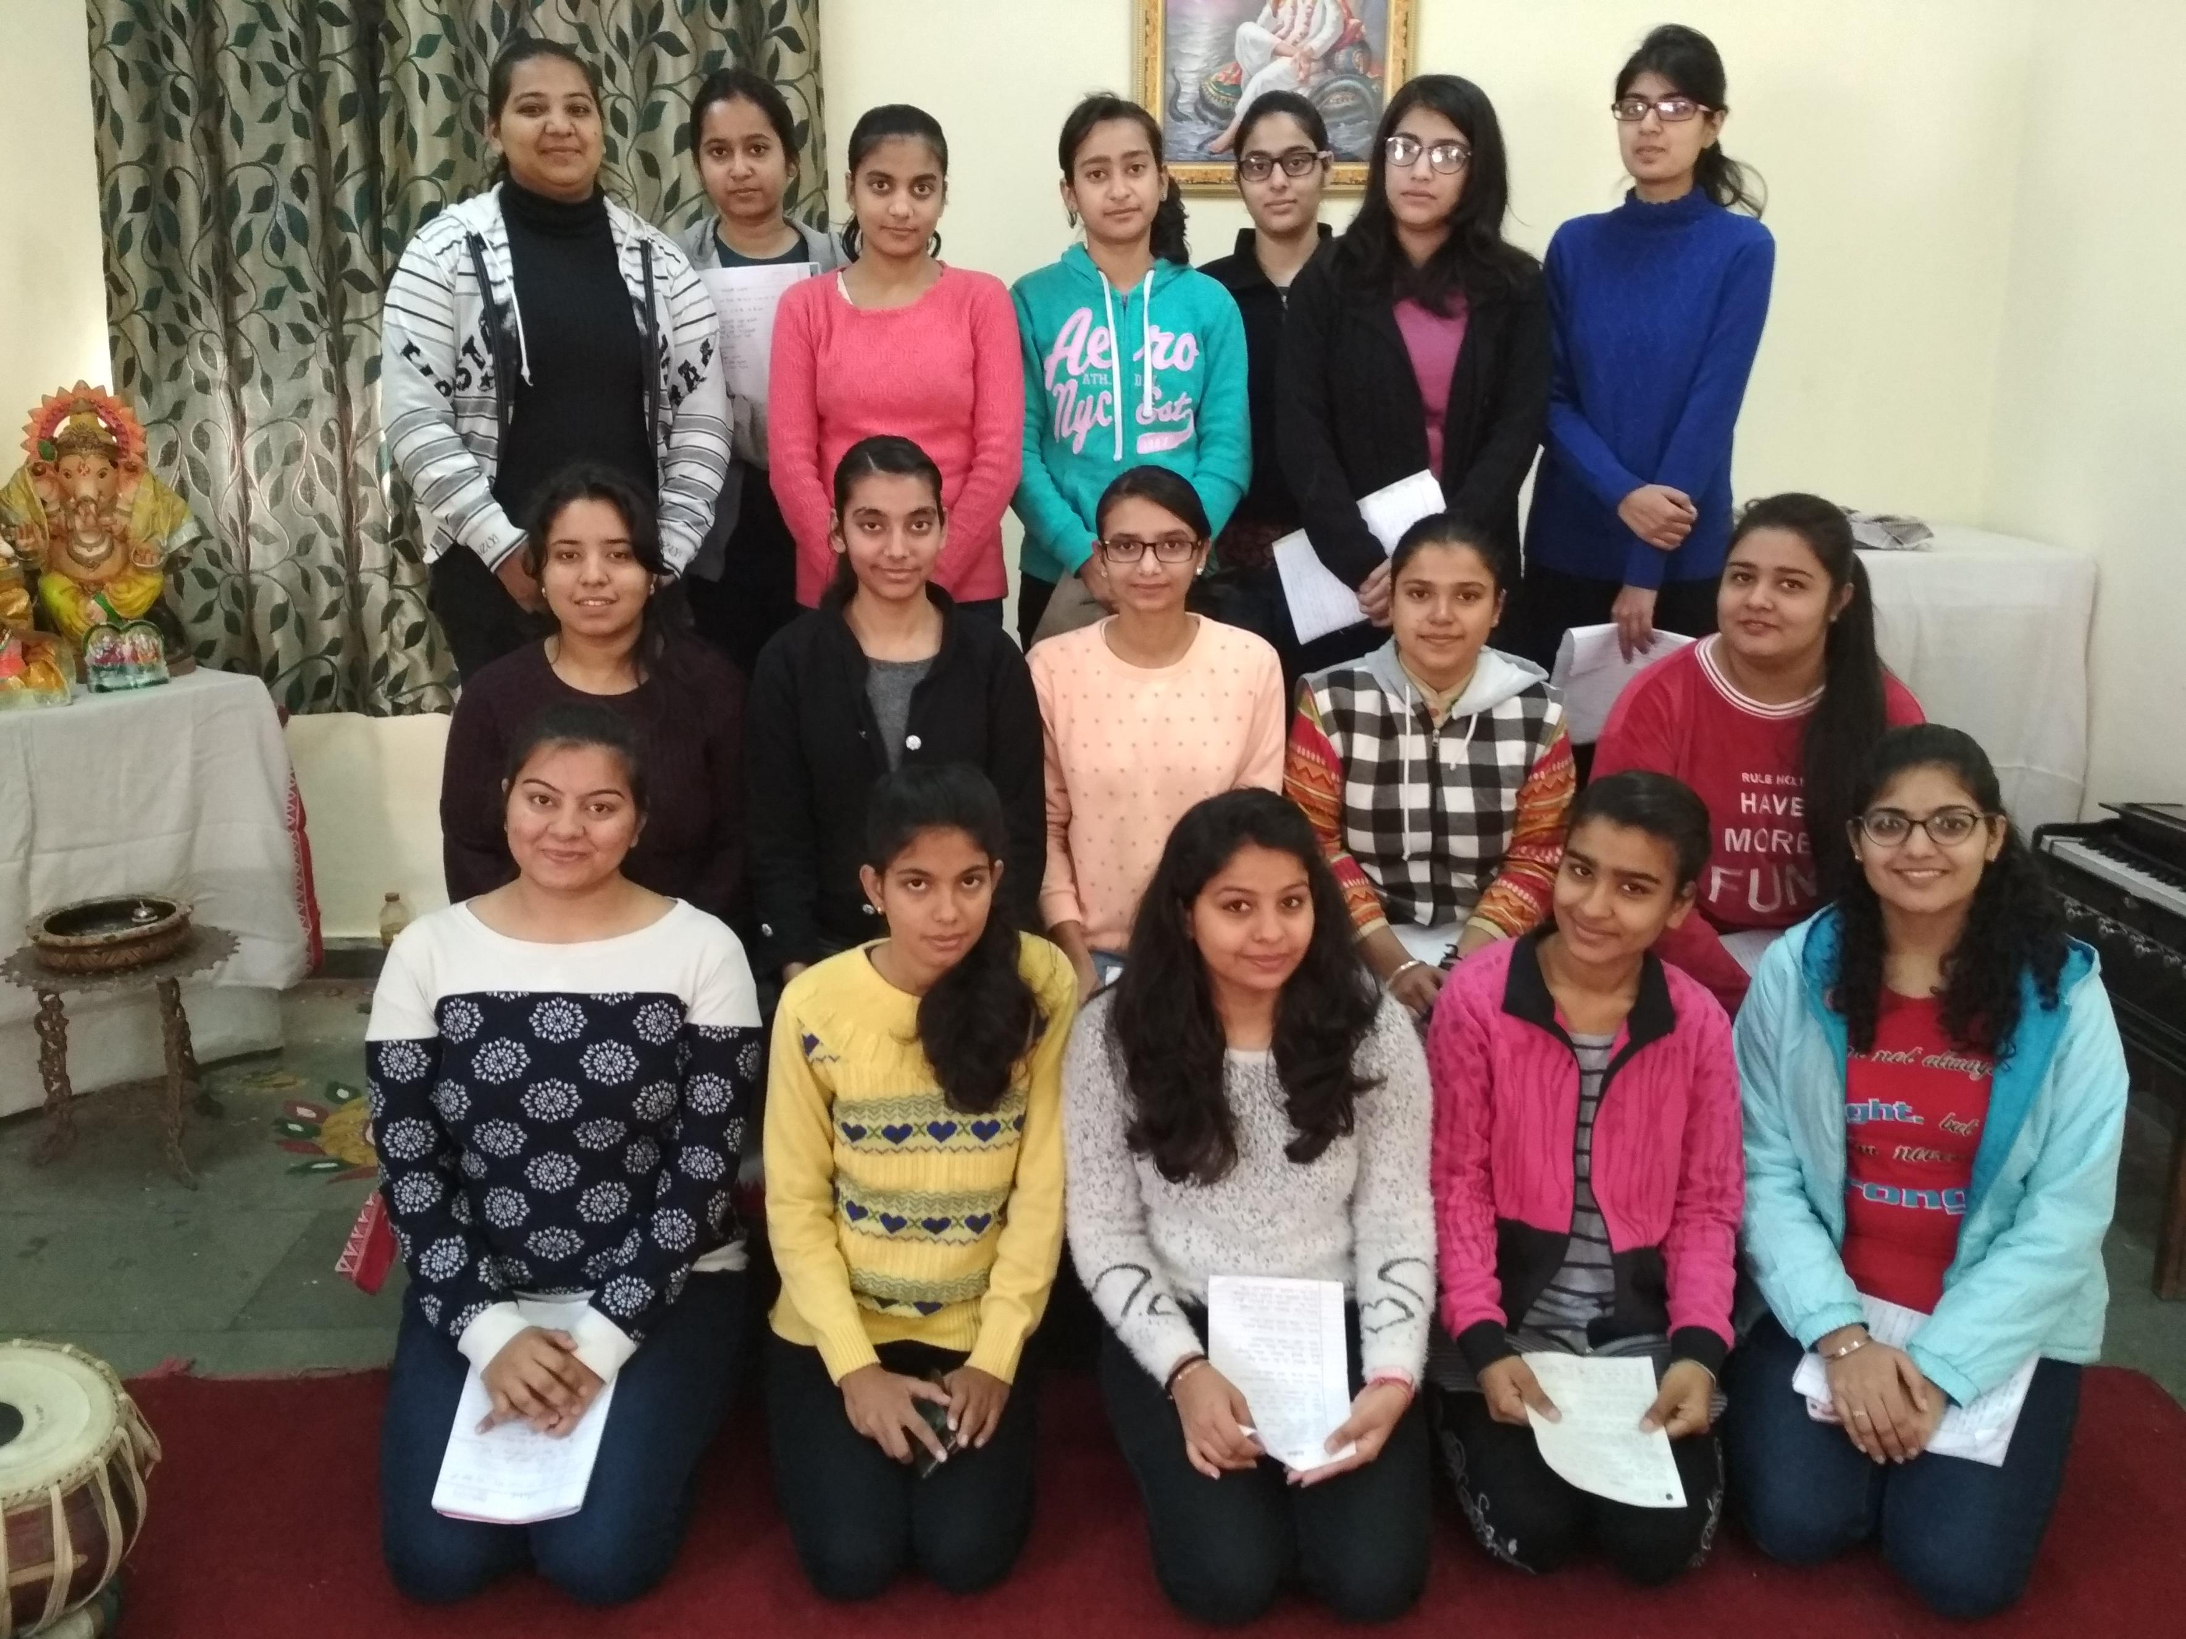
It was launched with the recitation of gurbani shabad by our own students. Under the banner college Giddha team was trained which performed at the college annual festival ‘Abhivyakti-2018’ and won the appreciation of all the spectators.

Slide 7
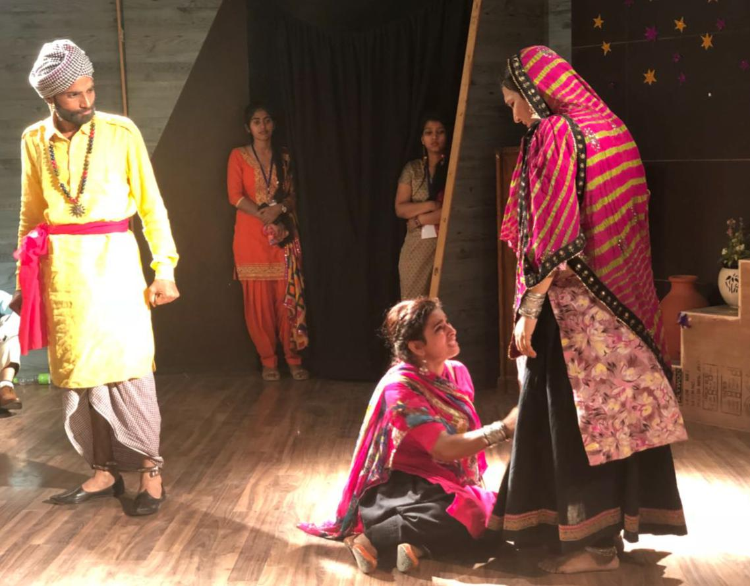
A Punjabi play ‘Channo Bajigarni’ written by famous playwright doctor C.D. Sidhu and directed by Ravi Taneja was staged in the college theatre room dated 28th March 2018 under the banner of our society.

Slide 8
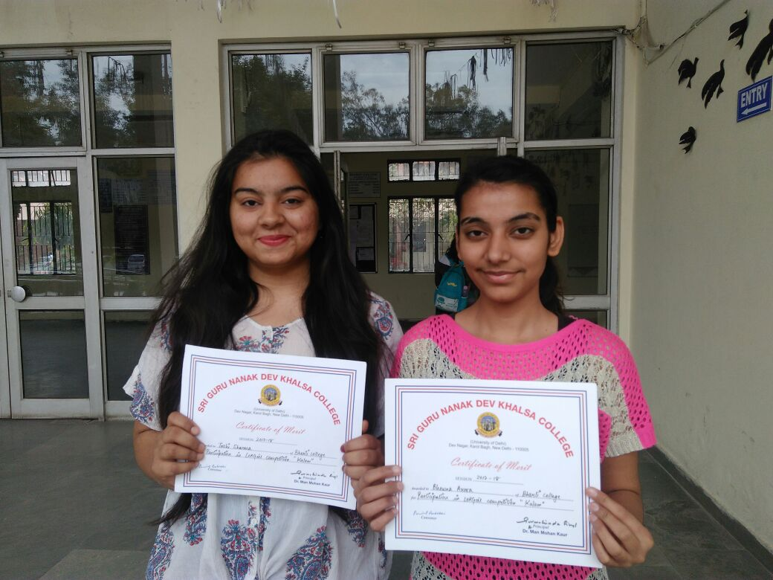
Department’s students Ms.Tashi Sharma and Ms. Bhavna Arora got special prize in folk singing at Shri Guru Nanak Dev khalsa college, Delhi.

Slide 9
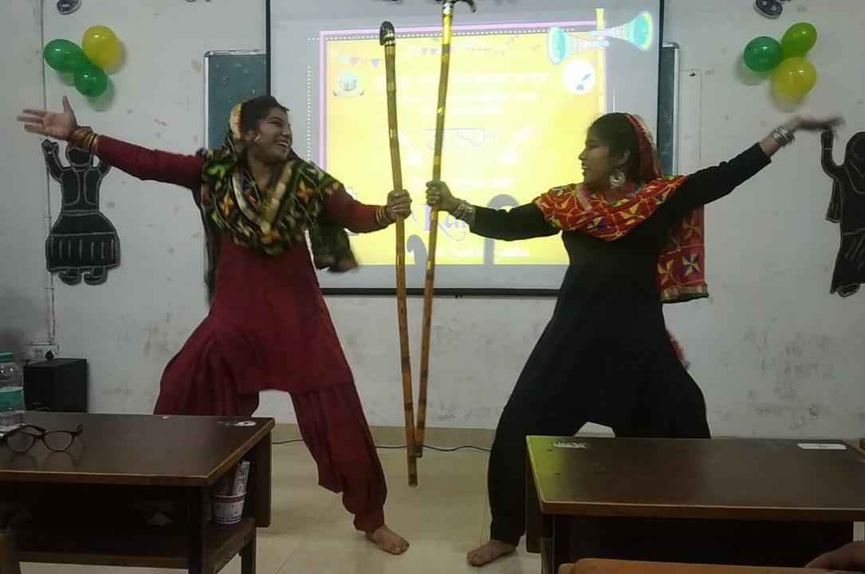
In the year 2019, Ms. Priyanka and Ms. Khushvinder Kaur got 1st prize in Folk dance competition .

Slide 10
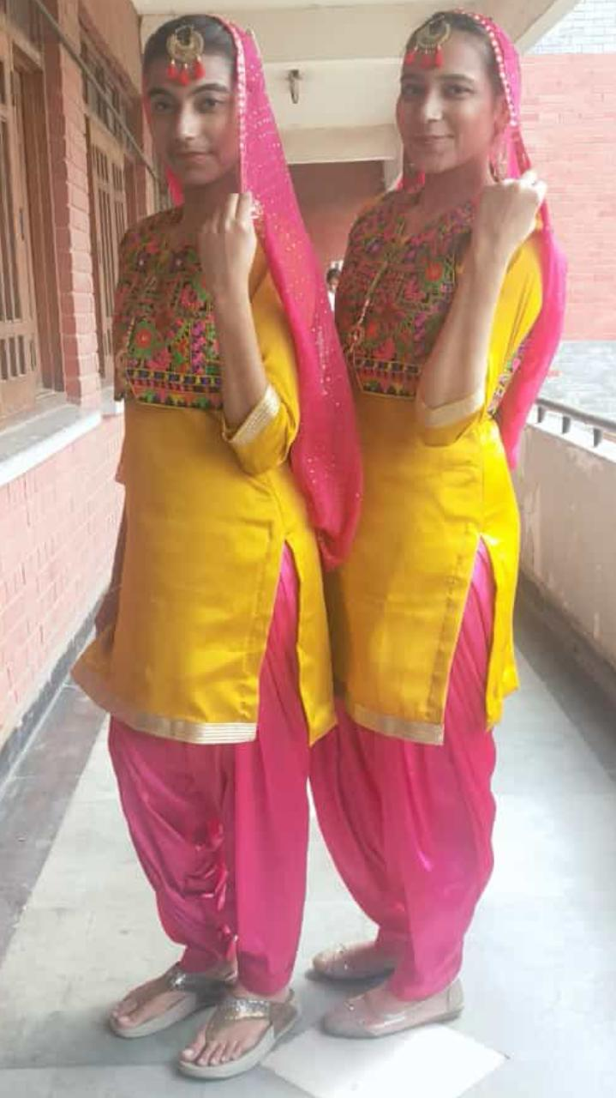
Ms. Ritu Arora and Bhavna Arora got 2nd position in Folk dance competition at Guru Gobind Singh college of commerce.

Slide 11
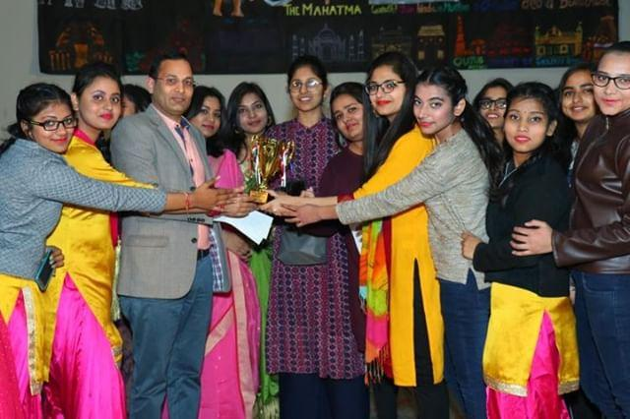
Our Punjabi dance team bagged 1st position at Satyawati college (evening)

Slide 12
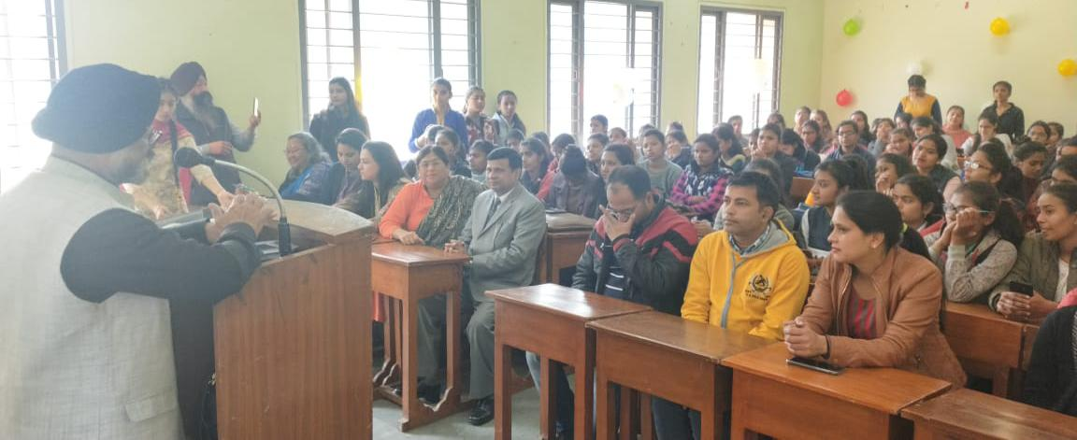
Our society organized an extension lecture on the occasion of 550th birth anniversary of Shri Guru Nanak Dev Ji on 11th February ,2019 .The lecture was delivered by chairman Gurmat College Shri,Harinder pal singh.

Slide 13
On 23rd April,2019 department of Punjabi Organized as special program for counseling of students.The experts namely Dr. Harmeet Singh ,Prof.Rawali singh, Dr.Prithvi RajThapper, Shri. Sukhwinder Singh guided the students to avail the opportunities in private/service sector which includes media translations interpretations culture and the event management. The students enthusiastically made queries for the courses to be opted in higher education.This was very fruitful program in which students not only from Punjabi subjects but from other facilities took part.

Slide 14
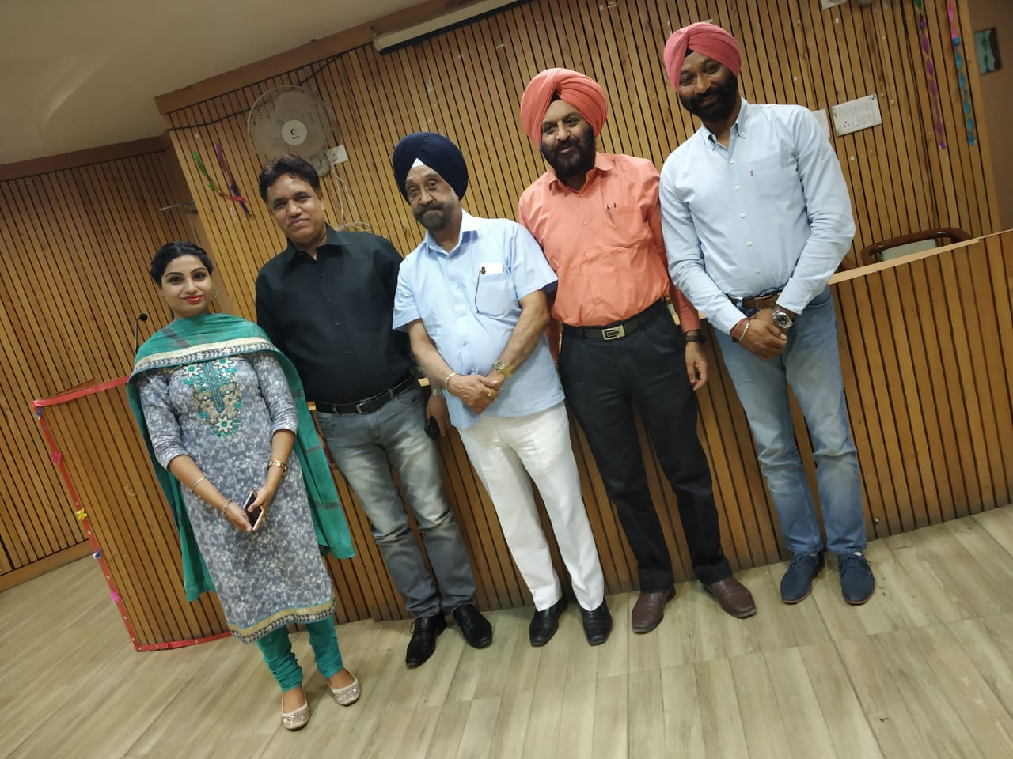

Slide 15
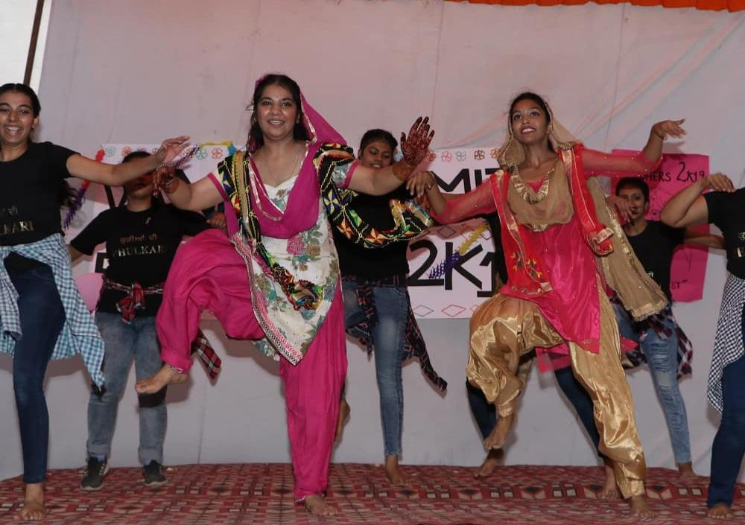
Khushvinder Kaur and Pawanpreet Kaur both won the laurels for the Phulkari Society when they won the 1st prize in Folk dance competition at Bharati College.

Slide 16
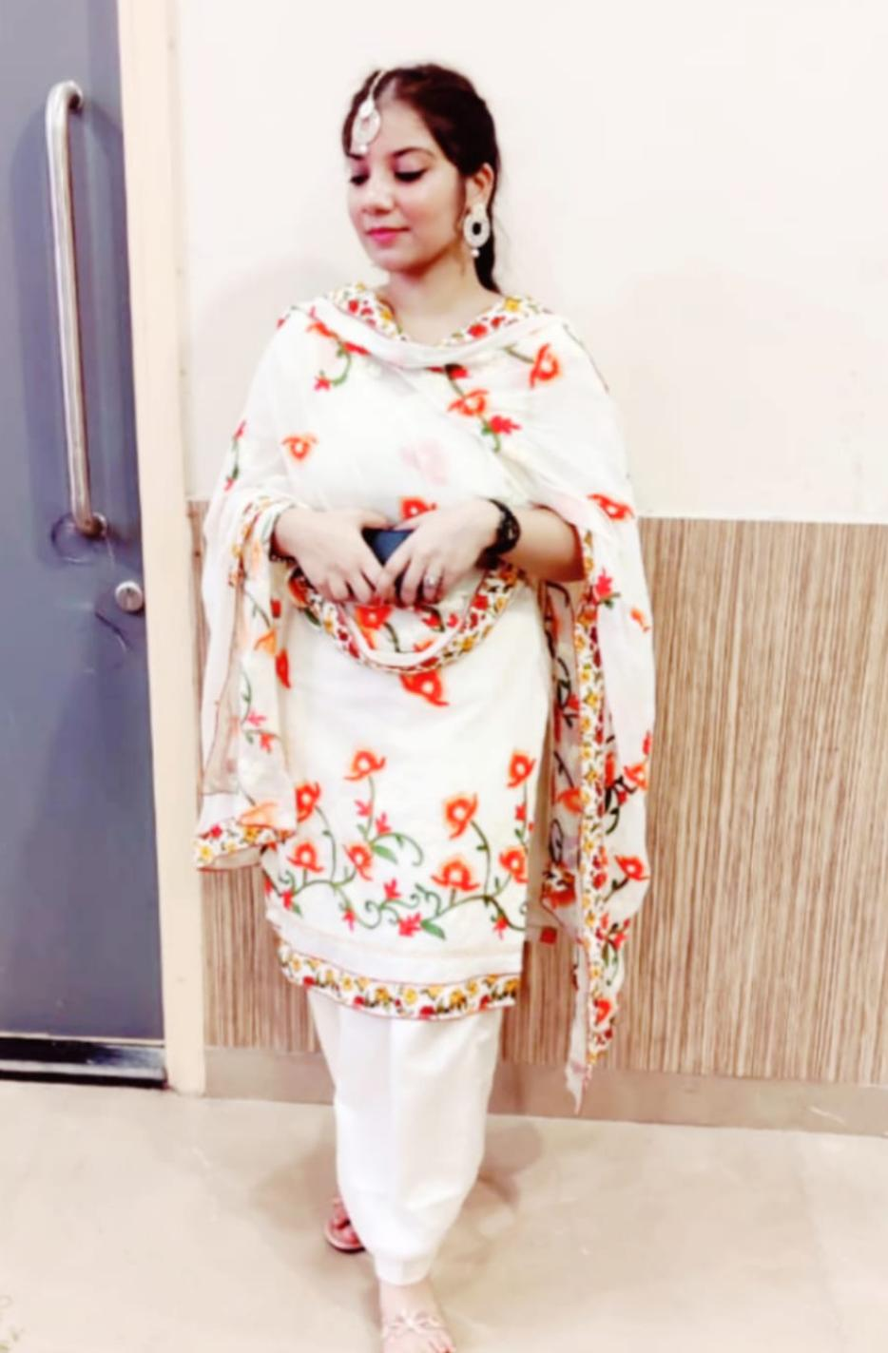
Khushvinder Kaur got 3rd prize in Dance competition at Bharati College.

Slide 17

Miss. Palak got second prize in solo for singing competition held at S.G.N.D Khalsa College.

Slide 18
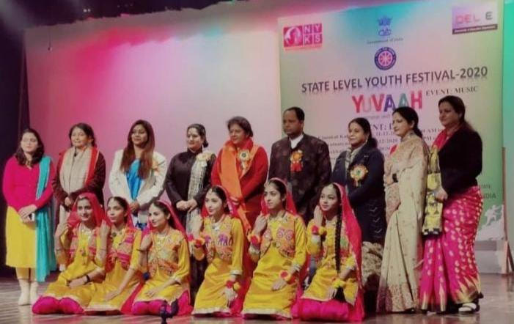
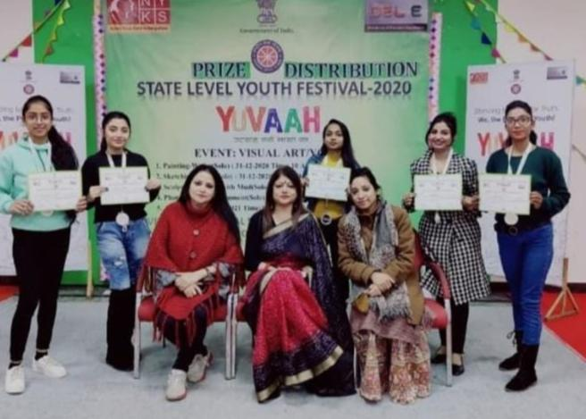
We are very happy to announce that “KUDIYAN DI PHULKARI” team won 2nd place at the “STATE LEVEL” YOUTH FESTIVAL, a competition held on 1st January, 2021.

Slide 19
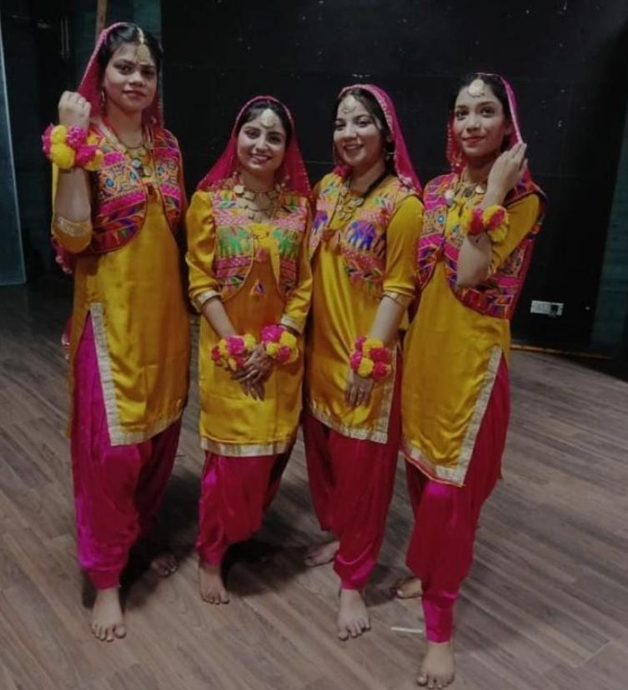
Our team won 1st place at the inter-college Folk dance competition held by Hindi Department of JESUS AND MARY COLLEGE, University of Delhi, on the 17th of March, 2021.

Slide 20
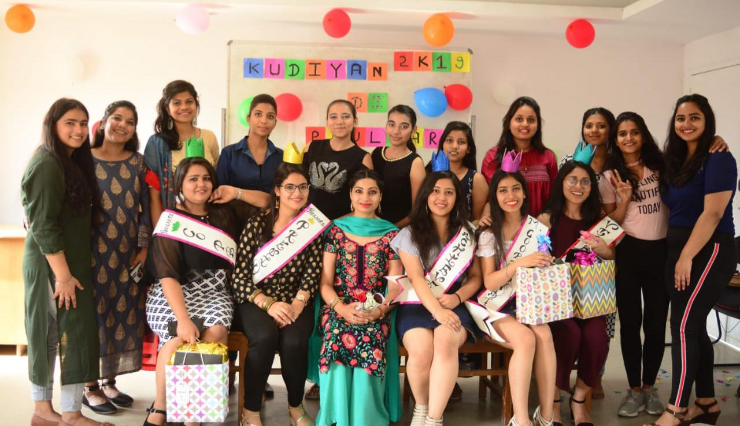
With the impact of these efforts number of students opting Punjabi subject is steadily increasing which is now almost the double of the last year .

Slide 21
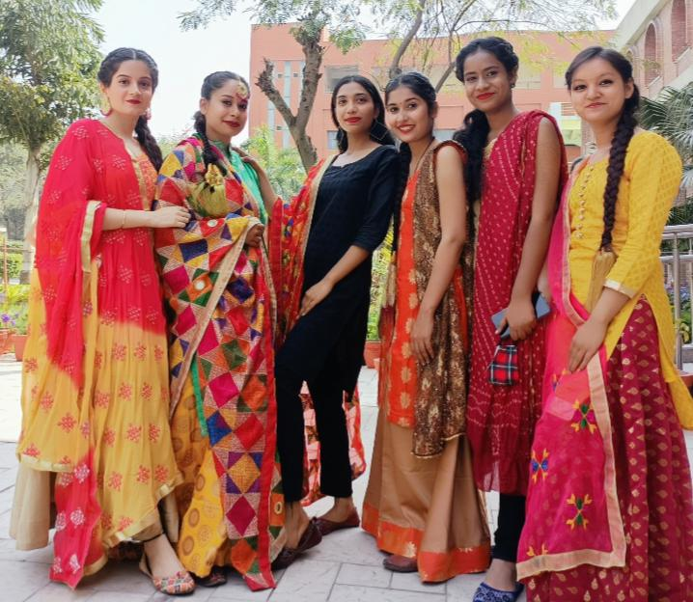
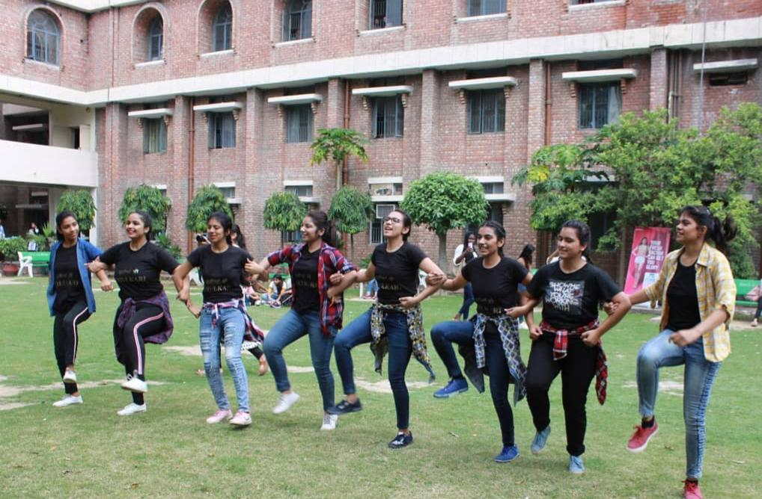
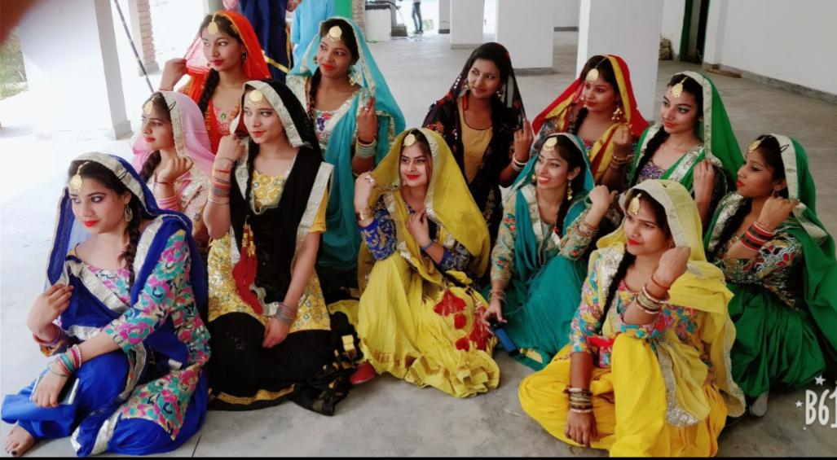
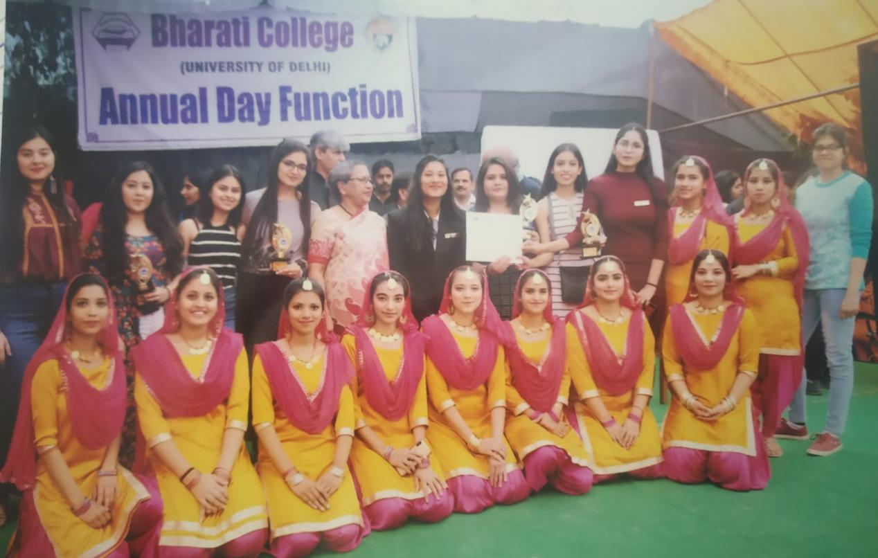

Slide 22
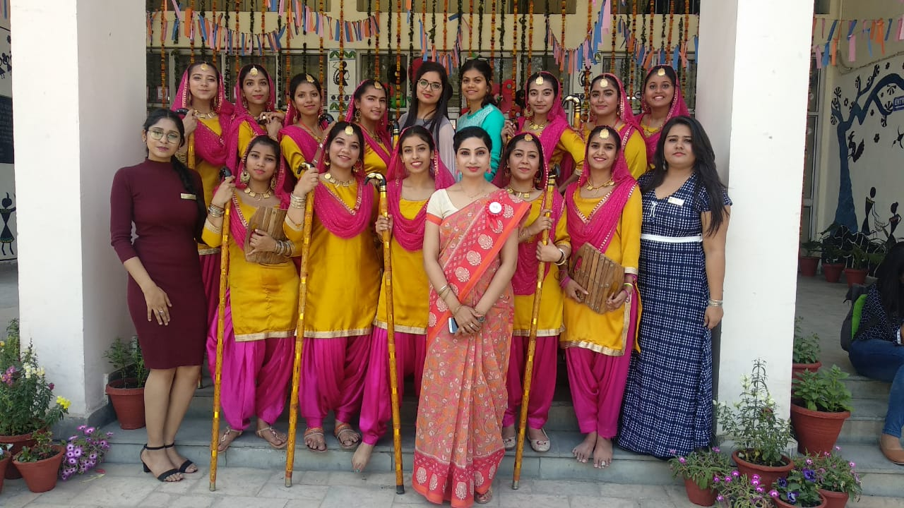

Slide 23
Thanking you

