Slide 1
MANTHAN-THE NUKKAD NATAK SOCIETY, BHARATI COLLEGE ANNUAL REPORT: 2022-2023
“I raise up my voice – not so that I can shout, but so that those without a voice can be heard.”
~ Malala
Manthan,The Nukkad Natak Society of Bharati college has never failed to raise their voice for spreading awareness among people and enlightening the youth on social causes.
MANTHAN wants nothing more than to support community through opportunities to gather, to reconnect with the greater circle we exist in.
As the new year approaches, we take a moment to reflect on everything our team has accomplished. This is a tribute to the dedication and innovation shown by our team.
1. RED LIGHT ON, GAADI OFF ACT [16TH NOVEMBER 2022]
On 16th November 2022 Manthan, The Nukkad Natak Society of Bharati college collaborated with Palaash, The eco club of Bharati college and performed a streetplay “RED LIGHT ON GAADI OFF” in order to spread the awareness on traffic rules. The aforementioned initiative was taken up by the Delhi government.
As the name “ RED LIGHT ON, GAADI OFF” itself specifies, it requires the drivers to turn off their ignition when the traffic light turns red. The initiative was proposed in 2020 keeping in mind the rising pollution levels in the city.
The members of the society also received the certificates of merit from the eco club as an appreciation for performing wonderfully.

Slide 2
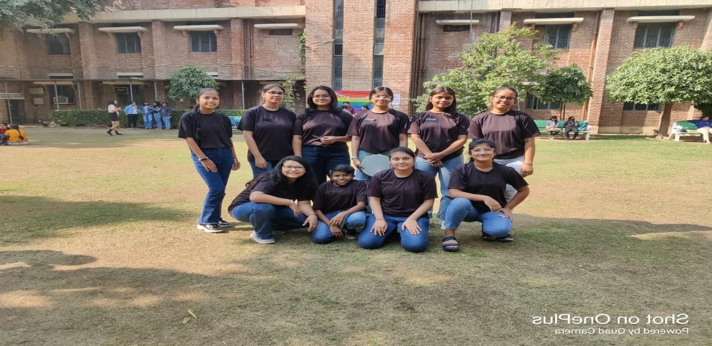
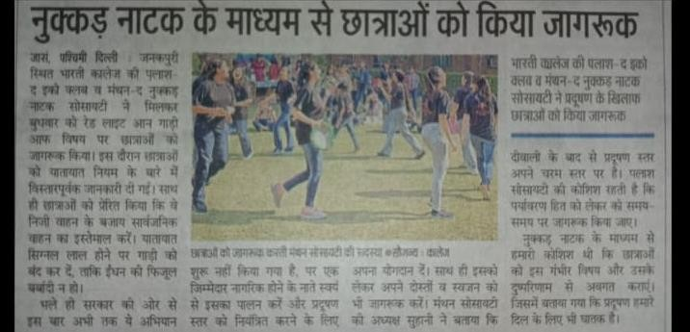
The Streetplay was performed in the central lawn of Bharati college and it also got featured in Dainik Jagran as it joined hands to depict a major issues of pollution by vehicles.
2. AUDITIONS 2022-2023 [23rd November 2022]
On 23rd November, Manthan-The Nukkad Natak society of Bharati college organised its auditions for academic year 2022-2023. The

Slide 3
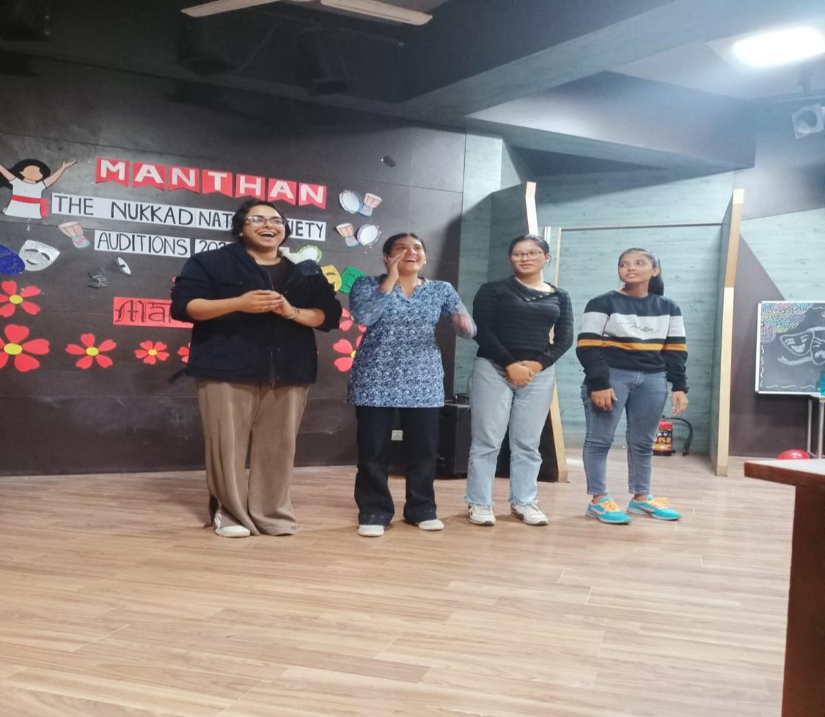
auditions were opened for all three years. Manthan received an overwhelming response from the students and more than 100 students appeared for auditions but only 16 students were selected after a tough battle of rounds.
The students were asked to prepare a monologue on any social issue and the criteria for the selection of members was on the basis of their acting, loudness of voice, confidence and charisma.
The auditions were taken by Suhani Sabharwal who is the PRESIDENT of Manthan- The Nukkad Natak Society.
The auditions was a booming success with the selection of 10 students from first year and 6 from second years.

Slide 4
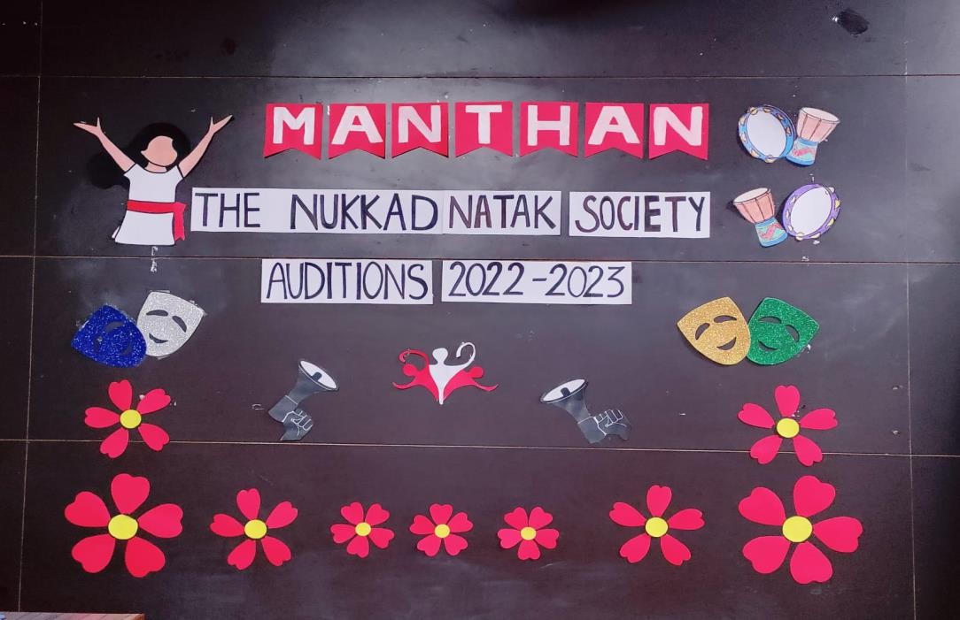
3. ORIENTATION PROGRAMME [1st December 2022]
In order to orient the newly selected members an orientation programme was held by Manthan-The Nukkad Natak society of Bharati college near auditorium building on 1st December, 2022 from 12PM onwards.
The programme started with the introduction of core members and the introduction of our convenor Dr. Bindia Trivedi and our co- convenor Dr. Shivani Saxena.
Suhani Sabharwal, the President of Manthan- The Nukkad Natak society introduced about the rules and regulations of society and the working of manthan. She also traced back to the history of manthan and gave a brief of achivements and aim that manthan carries. The programme came to an end by introduction of all the members and their expectations from society.

Slide 5
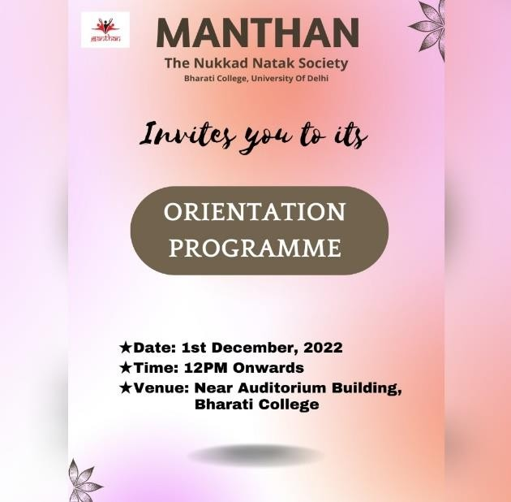
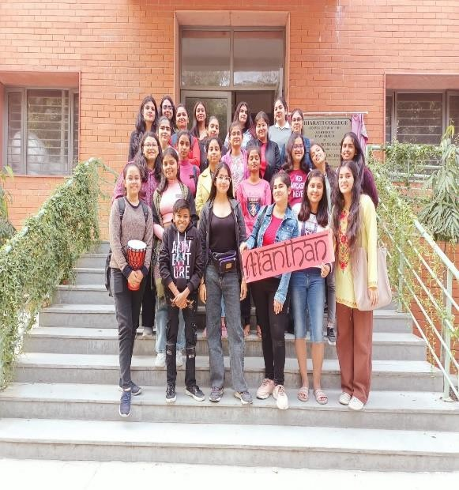
4. FLAKES’23, Winter Carnival OF MANTHAN [25TH JANUARY,2023]
Manthan-The Nukkad Natak Society of Bharati College successfully organized its WINTER CARNIVAL FLAKES'23 on 25th January 2023. The event occurred in the Central Lawn of Bharati college with a footfall of over 500 people.
The annual society fest, Flakes’23 started with an exciting and enraging Open mic competition where students from various departments cast their talent for public speaking. This included singing performances, stand-ups, and poem recitations in the competition.
The winter carnival was open for girls from all colleges. It provided the guests with various stalls, including food, accessories, games, decor items, a lucky draw, etc.

Slide 6
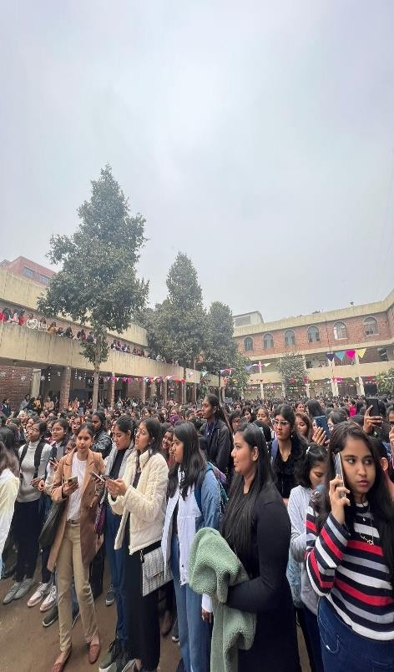
Manthan itself set up two stalls which included games and accessories. The society was successful in generating funds for itself by setting up 2 stalls and convincing over 10 paid sponsors to be a part of Flakes'23.
The program also included an elated dance performance by Mridang- The Music and Dance Society of Bharati College university of Delhi along with a mesmerizing and melodious singing performance by Mr. Abhishek.
Ultimately exciting prizes were given to the lucky draw winners and at last, the showstopper has to be the street play performance which was presented and prepared by team Manthan.
FLAKES’23 came to be as a successful event with the hardwork of all the team members and with the support of convenor and co- convenor.

Slide 7
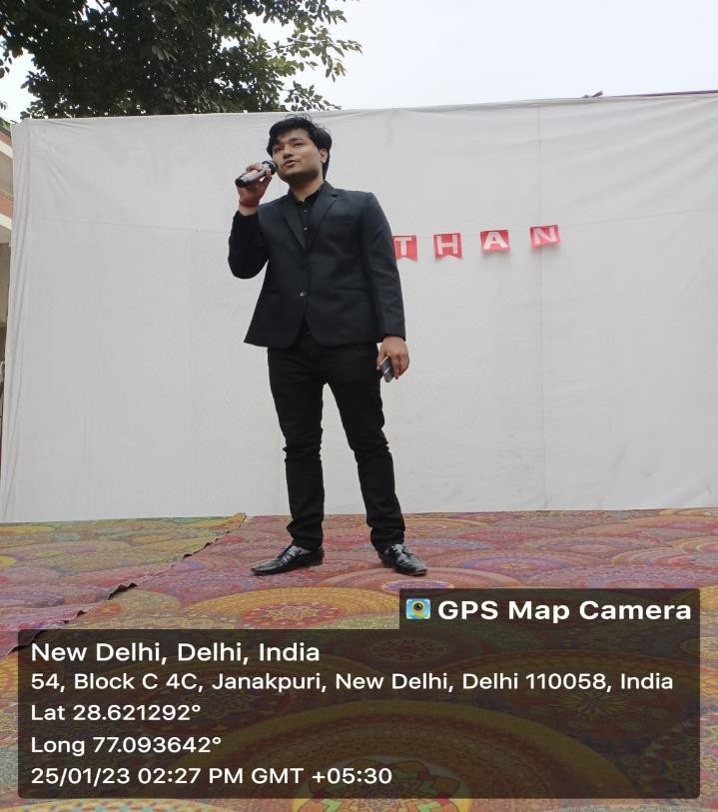
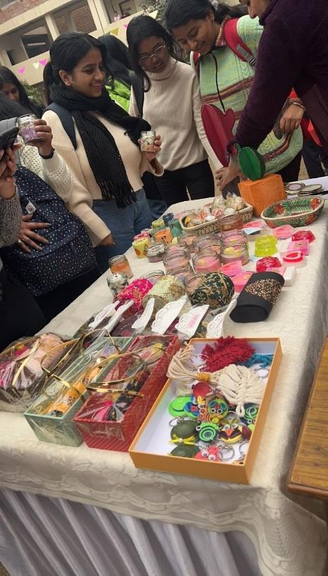
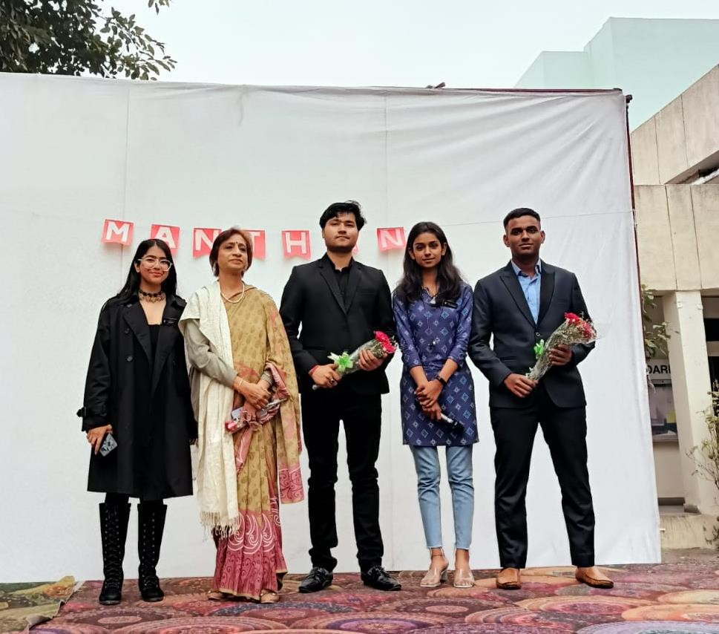

Slide 8
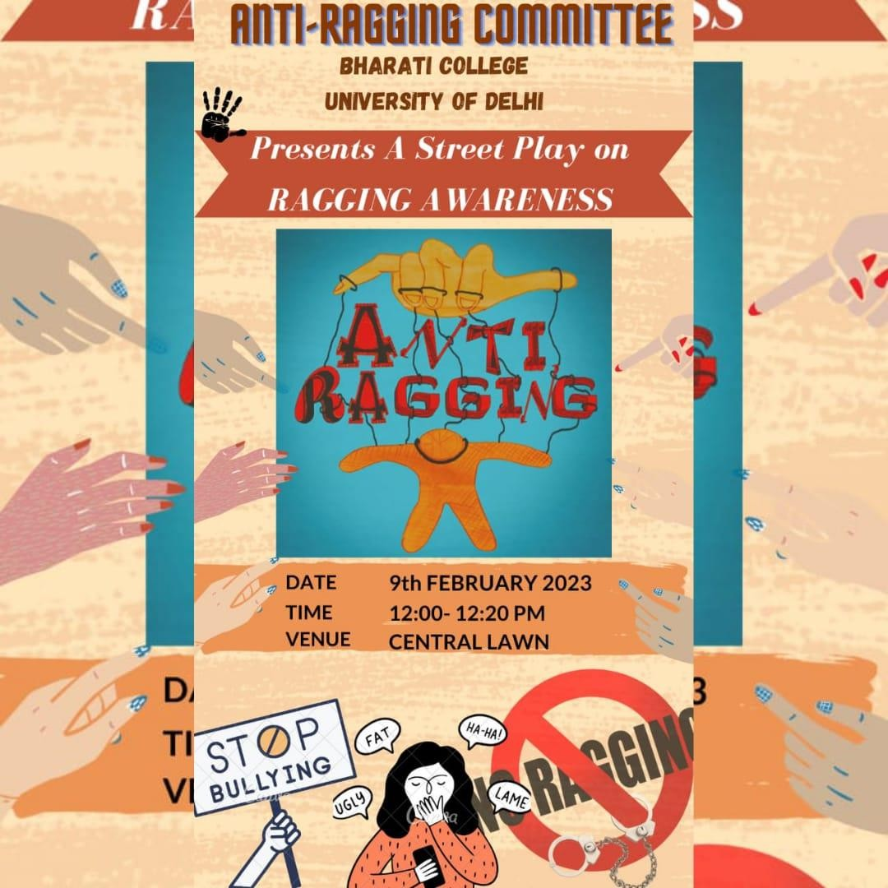
5. RAGGING AWARENESS ACT [9TH FEBRUARY 2023]
Ragging is one of the most common crime that one faces during college times. Ragging though seems not very dangerous but leaves a scar in the mind of victims forever and in some cases this scar makes teenagers take a step so serious that it might cost them their lives.
To make teenagers aware of this issue Manthan- The Nukkad Natak Society of Bharati College performed an act on Anti-Ragging in collaboration with the Anti-Ragging committee of Bharati College.
The act was performed within the college premises on 9th February. The act included the issues concerning the harmful effects of Ragging and bullying that teenagers face and how it affects their mental as well as physical well-being.

Slide 9
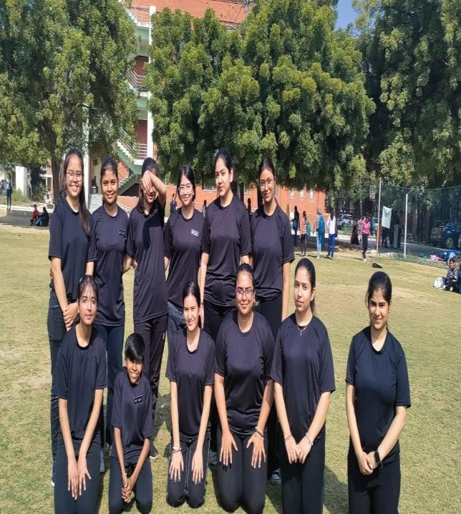
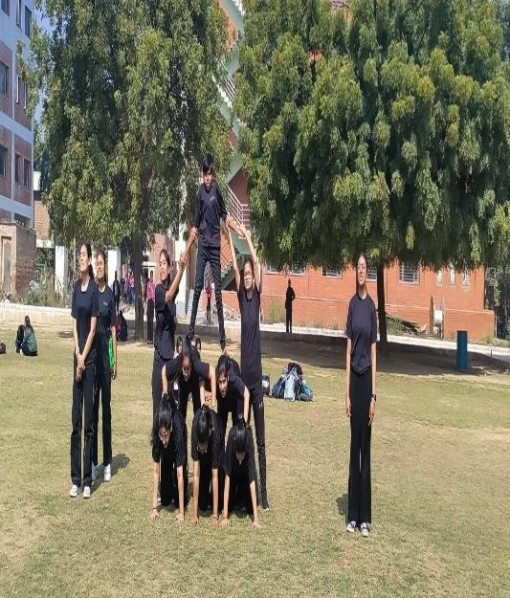
The act also inspired the students to step forward and courageously stand against such practices that might ruin a person's life just for the enjoyment of many.
The act was much appreciated and well-received by the students of the college as well as the Anti-Ragging Committee. The act truly displayed the spirit of Nukkad Natak, which is spreading awareness, with the thunderous applause of the spectators.
6. TAMAASHEBAAZI’23 A STREETPLAY COMPETITION [10TH APRIL, 2023]
The Annual fest of Bharati College was a successful event and so was TAMAASHEBAAZI' 23 which was an inter college streetplay competition organized by Manthan- The Nukkad Natak society of Bharati College under the umbrella event of the annual fest ABHIVYAKTI' 23.
The members of manthan worked hard and did promotion of fest in online and offline both modes and got 450+ partcipants and a total of 22 teams from reputed institutions like IIT Delhi, Hansraj college, ARSD, Kirori mal college and many more.

Slide 10
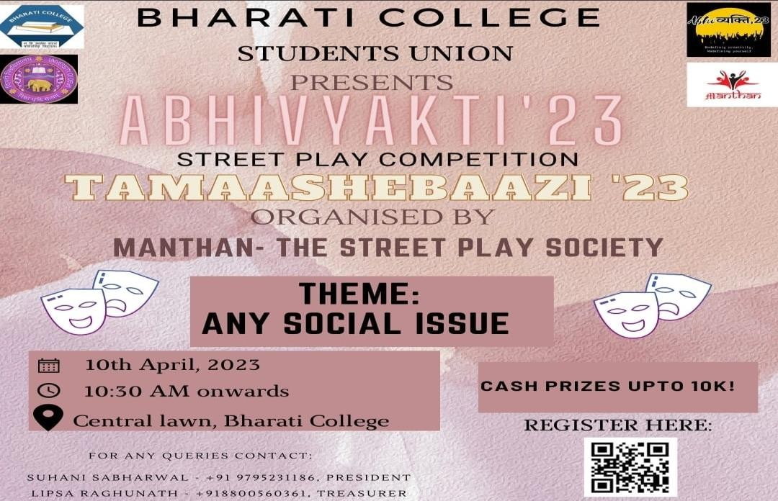
On 10th April, 2023 the event occurred without any setbacks from felicitating of our guest Mr. Rohit Tripathi who is a well know TV actor and has been seen in a movie ‘Shubh Mangal Zyaada Savdhaan’ recently. He has also worked with National School Of Drama and has received a fellowship award in theatre from Ministry of Culture, Government of India
The competition began from a common call which became the very spirit of the event. The call literally raised goosebumps of whoever heard it.
The enthusiasm and energy were incomparable. All the teams came forward together and grabbed everyone’s attention with their energy and recitation power.
The teams performed their nukkad natak on various social issues that introduced the audience to many existing issues in the societies that they didn’t even know about. The performances started at 11 am and every team was allowed to perform for maximum 25 minutes. The event ended by 4 pm and the event ended with the announcement of results and distribution of cash prizes, gift hampers, trophies as well as the merit and participation certificates.

Slide 11
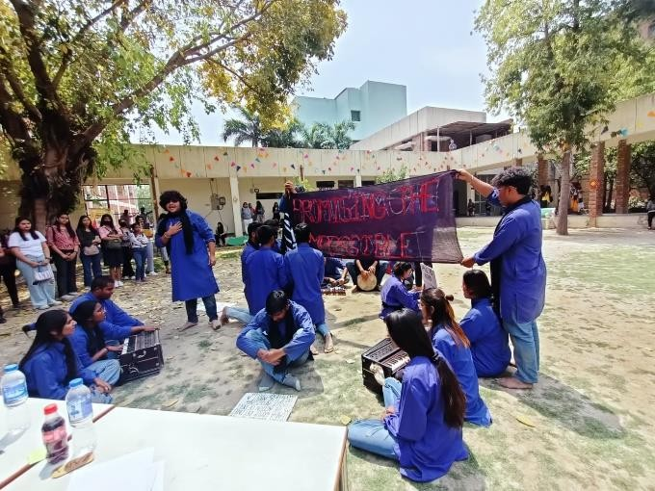
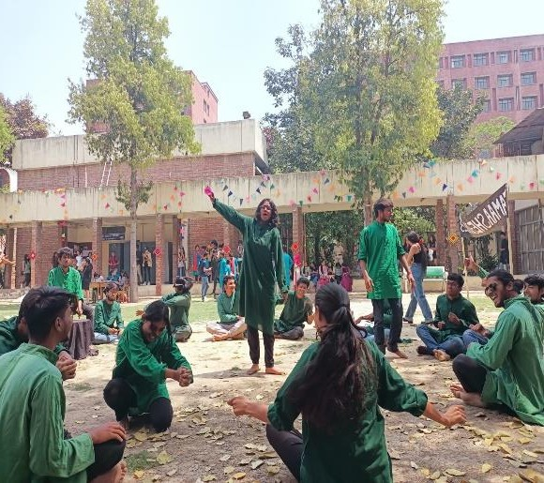
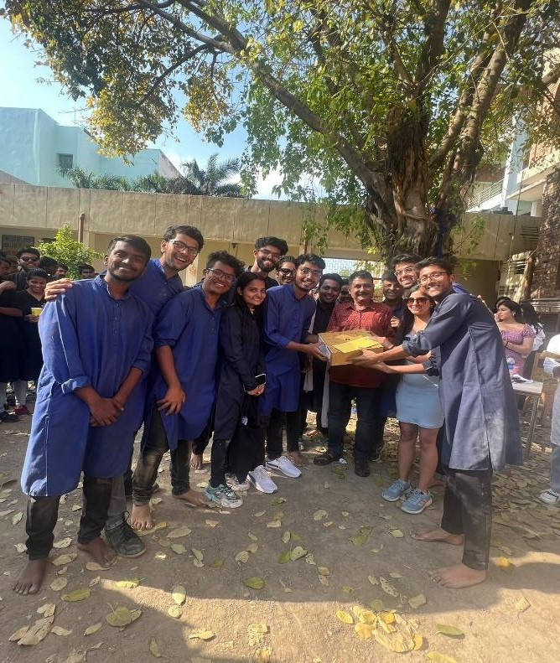
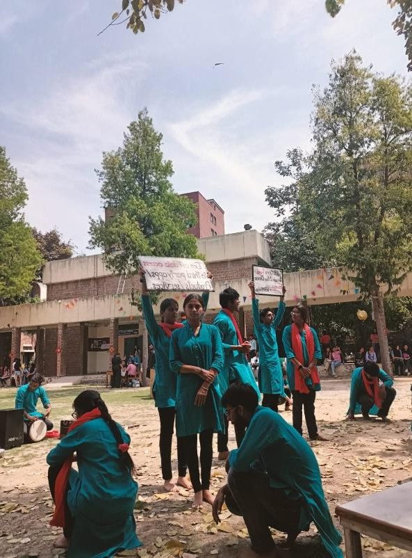

Slide 12
SOCIAL MEDIA HANDLE OF MANTHAN
https://www.instagram.com/tv/ClHJOFsjW6R/?igshid=YmMy MTA2M2Y=
https://www.instagram.com/reel/CldHIJgDEKm/?igshid=YmM yMTA2M2Y=
https://www.instagram.com/p/ClocLIAyG5I/?igshid=YmMyMT A2M2Y=
https://www.instagram.com/reel/Cn_ZIHcj130/?igshid=YmMy MTA2M2Y=
https://www.instagram.com/reel/CrLnEQ7MV2-
/?igshid=YmMyMTA2M2Y=
https://www.instagram.com/p/Cpu99hLv2sb/?igshid=YmMyM TA2M2Y=
https://www.instagram.com/p/Cntf7SIyBUi/?igshid=YmMyMT A2M2Y=
https://www.instagram.com/p/ClEHbmQSNBO/?igshid=YmM yMTA2M2Y=
https://www.instagram.com/reel/CoPoS1Zjkn5/?igshid=YmM yMTA2M2Y=
FOR MORE DETAILS CONTACT:
manthannukkadnataksociety@gmail.com
https://instagram.com/manthannukkadnataksoc?igshid=YmMyMTA2M2Y=

Slide 13
ANNUAL ATTENDANCE REPORT 2022-2023
MEMBERS | RED |  |  | FLAKES’23 | RAGGING | TAMAASHEBAAZI
OF SOCIETY | LIGHT ON GAADI | AUDITIONS 2023-2023 | ORIENTATION PROGRAMME | SOCIETY FEST | AWARENESS ACT | ANNUAL FEST (ABHIVYAKTI’23)
 | OFF
 | ACT
Suhani Sabharwal | 3 | 1 | 1 | 9 | 4 | 9
Tanu Rao | 3 | 1 | 1 | 9 | - | 8
Vanshika | 3 | 1 | 1 | 9 | - | 8
Lipsa Raghunath | 3 | 1 | 1 | 9 | 4 | 8
Nancy | 3 | 1 | 1 | 9 | 4 | 8
Anushka | 3 | 1 | 1 | 7 | 2 | 8
Pragati | - | 1 | 1 | 7 | - | 8
Riya | 3 | 1 | 1 | 7 | 2 | 8
Richa | 3 | 1 | 1 | 7 | - | 8
Drishti | 3 | 1 | 1 | 9 | - | 5
Sujata | - | 1 | 1 | 9 | 2 | 8
Kanishka | 3 | - | 1 | 2 | - | 1
Khushbu | 3 | - | 1 | 2 | - | 1
Nivedita | 3 | 1 | 1 | 7 | - | 8
Jagriti | - | 1 | 1 | 7 | 4 | 8
Tazeen | - | 1 | 1 | 7 | - | 8
Janvi | - | 1 | 1 | 7 | - | 8
Disha | - | 1 | 1 | 7 | - | 4
Renu | - | 1 | 1 | 6 | 4 | 5
Srishti | - | 1 | 1 | 7 | - | 6
Maria | - | 1 | 1 | 7 | - | 7
Suhani Kaur | - | 1 | 1 | 5 | 4 | 7
Bhavya | - | 1 | 1 | 7 | 4 | 7
Aparna | - | 1 | 1 | 7 | 4 | 7
Parinta | - | 1 | 1 | 7 | 4 | 7
Shreya | - | 1 | 1 | 7 | - | 7
Nandini | - | 1 | 1 | 7 | 4 | 8
Disha Dhingra | - | 1 | 1 | 7 | 4 | 8

Slide 14
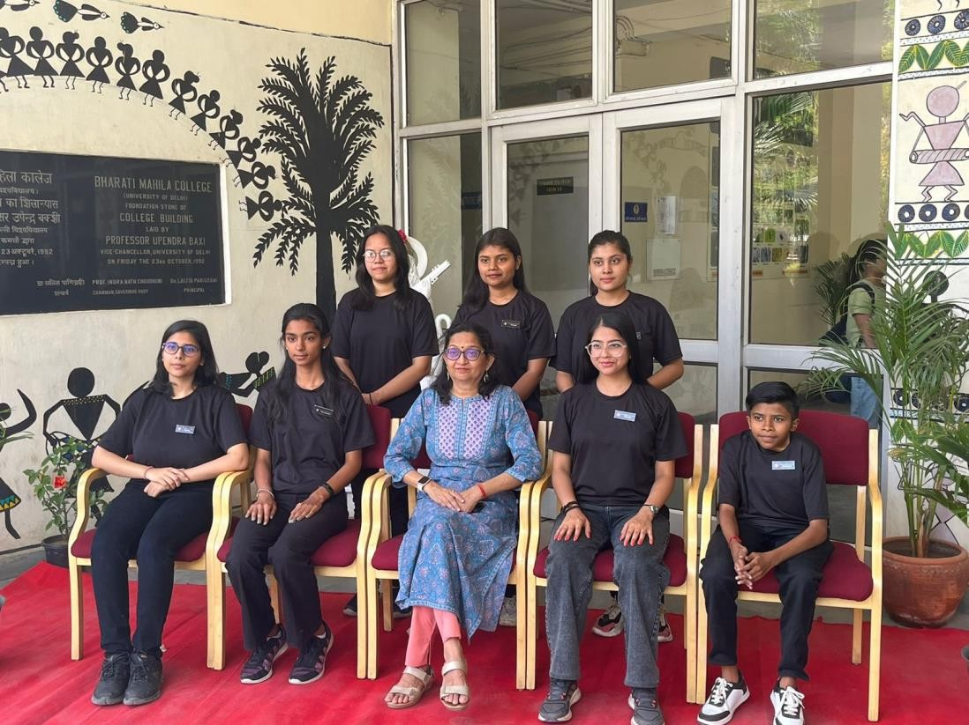
MANTHAN CORE TEAM: 2022-2023
(From L to R, top row Riya Aggarwal, B lipsa Raghunath, Anushka Dwivedi)
( From L to R, bottom row Vanshika, Tanu Rao, Dr. Bindia Trivedi, Suhani Sabharwal, Nancy)
CORE MEMBERS:
SUHANI SABHARWAL [PRESIDENT]
TANU RAO [VICE-PRESIDENT]
B LIPSA RAGHUNATH [TREASURER]
VANSHIKA [SECRETARY]
MANTHAN HEADS:
NANCY [SOCIAL MEDIA HEAD]
RIYA AGGARWAL [CREATIVE HEAD]

Slide 15
SCRIPTWRITERS:
ANUSHKA DWIVEDI
PRAGATI YADAV [volunteer]
SENIOR EXECUTIVE MEMBERS:
Richa Singh
Drishti Sharma
Sujata Sharda
Kanishka
Khushbu
Nivedita Banerjee
Jagriti Mishra
Pragati Yadav
Tazeen Asra
Janvi Verma
Disha
Renu
Srishti Bansal
EXECUTIVE MEMBERS:
Maria Ahmad
Suhani Kaur
Bhavya
Aparna Gosain
Parinita Sahani
Shreya Oberoi
Nandini Dang
Disha Dhingra
CONVENORS:
Dr. Bindia Trivedi [convenor]
Dr. Shivani Saxena [co-convenor]

