Slide 1
MANTHAN-THE NUKKAD NATAK SOCIETY
BHARATI COLLEGE
UNIVERSITY OF DELHI
ANNUAL REPORT: 2023-2024
“Words mean more than what is set down on paper. It takes the
human voice to infuse them with deeper meaning.”
~Maya Angelou
Manthan, The Nukkad Natak Society of Bharati College, is a bright example of social
consciousness and activism. They have effectively raised important social concerns
to the attention of young people via their steadfast dedication, making a lasting
impact on both individuals and communities. Beyond the sphere of performances,
MANTHAN is an essential forum for strengthening ties within the community and
reviving ties to the larger social fabric. It's a sombre opportunity to consider the
team's amazing accomplishments as the new academic year draws near. Their
inventive spirit and perseverance have been crucial in bringing about constructive
change.
Manthan aims to empower the voiceless, spark important dialogues, and inspire
meaningful deeds in addition to merely increasing awareness. It encourages the
greater community to actively participate in tackling societal issues while also
enabling its members to become change agents. Beyond the walls of Bharati
College, Manthan's influence is felt in addressing issues of social justice and
inclusivity and gender equality. Let’s take a moment to honour Manthan's important
accomplishments and its continued legacy of activism and social responsibility as we
start a new year full of opportunities.

Slide 2
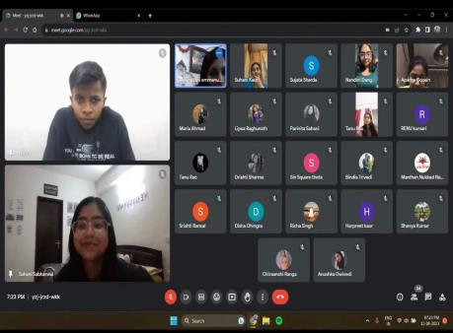
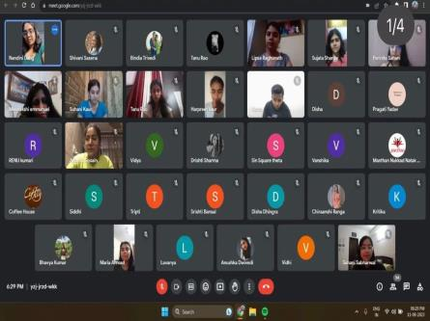
EVENTS OF THE ACADEMIC YEAR 2023-24
1)
TH
WORKSHOP ON HEALTH AND WELLNESS [11
August 2023]
In commemoration of Azadi Ka Amrit Mahotsav, Manthan- The Nukkad Natak
Society extended a warm invitation to Mrs. Meenakshi Emmanuel to deliver a
keynote address during an insightful webinar themed "Health and Wellness."
Renowned as both an educator and child counsellor, Mrs. Meenakshi Emmanuel
imparted invaluable advice to students, shedding light on ways to foster their
physical and emotional well-being. The event featured an engaging Q&A session,
allowing members to delve deeper into the subject matter, enriching their
understanding and learning. The session helped members in learning more about
their mental health and getting acquainted with tips and tricks to endure through long
practice sessions. These methods will help each member in making practice session
relaxing and comfortable.
.

Slide 3
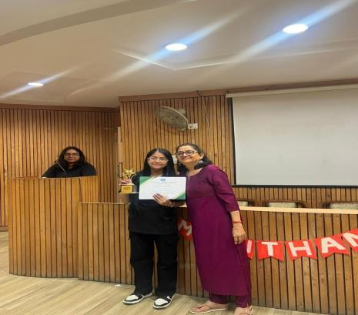
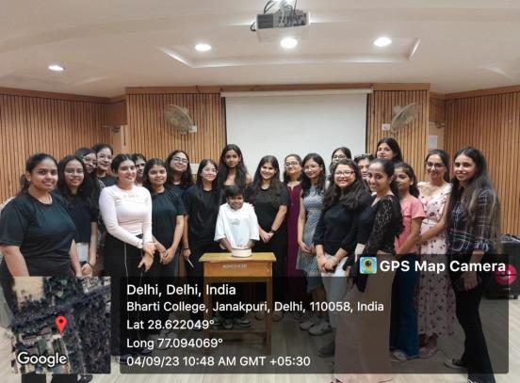
th
2) FAREWELL- CUM- INVESTITURE CEREMONY [4
September 2023]
The Society's "Farewell cum Investiture Ceremony" was a significant occasion that
combined continuity and change. It highlighted the commitment of present members
while honouring the efforts of past ones. The investiture of badge signified a new
phase that smoothly connected the past and the future. An emotional farewell that
blended optimism and nostalgia was given to the members who left.
President
Suhani Sabharwal led alongside the distinguished convenor, Dr. Bindia Trivedi.
Dr. Bindi Trivedi ma’am gave motivational remarks to kick off the celebration, and
there was a happy cake-cutting ceremony. Present office bearers offered their
perspectives, while president awarded certificates along with highlighting the
contribution of past participants. Motivational talks that fostered togetherness and
purpose concluded the ceremony. The long-lasting impact of former members
demonstrated their inspiration and guaranteed a continuity of principles.

Slide 4
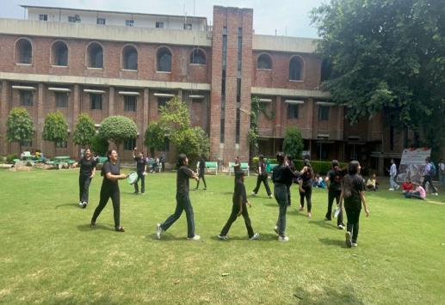
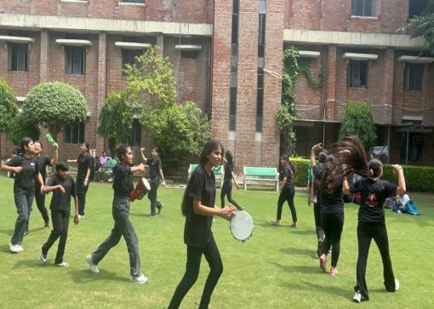
th
3) PROMOTIONAL ACT [12
September 2023]
Manthan - The Nukkad Natak Society embarked on a strategic promotional
campaign to disseminate awareness among all college students about its vibrant
presence and offerings. Through a meticulously planned promotional act, including
posters, flyers, and social media outreach, Manthan ensured comprehensive
coverage across campus. Leveraging the power of word-of-mouth, members
engaged actively with fellow students, articulating the society's mission, events, and
opportunities for involvement. Additionally, eye-catching act in central lawn served as
focal points, captivating the attention of passersby and sparking curiosity. By
employing a multi-faceted approach, Manthan effectively penetrated the student
body, fostering a sense of belonging and enthusiasm for participation in its dynamic
activities.

Slide 5
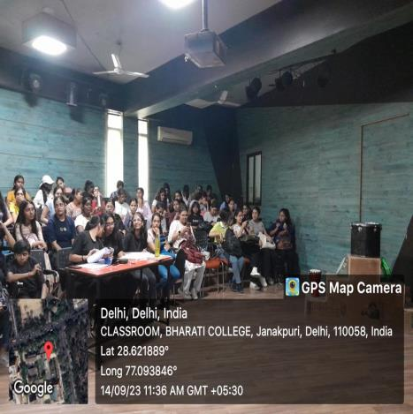
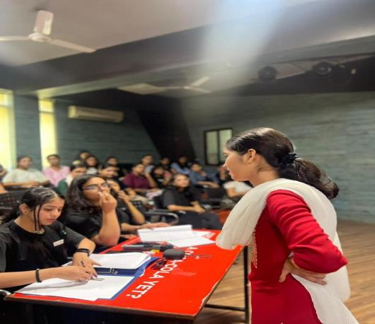
th
4) AUDITIONS’ 23 [ 14
September 2023]
The Society's Audition was a colourful event that exuded warmth and unity with
more than 150 participants who performed. President Suhani Sabharwal ascended
the stage as the curtains raised, her presence commanding attention as she opened
the auditions with a formal but passionate address. Her remarks set the tone for an
evening of profound performances meant to elicit contemplation and thought in
addition to providing entertainment. In every performance, the actors deftly explored
a wide range of societal topics, boldly taking on problems that frequently lurk in the
background of day-to-day existence. They illuminated the grim reality of rape, female
foeticide, domestic abuse, dowries, and mental health concerns with moving
portrayals and impactful dialogue.
.

Slide 6
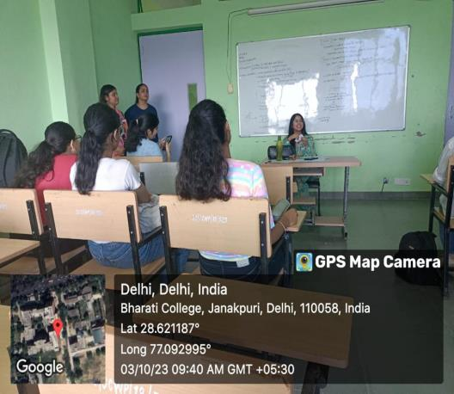
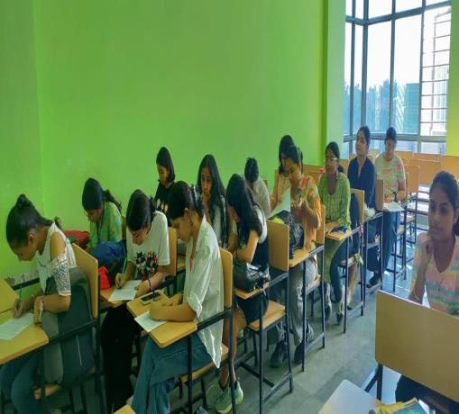
rd
5) ORIENTATION’23 [03
October 2023]
The orientation welcomed new members of the society with open arms. The
responsibilities of each office bearer were clearly defined, emphasising the value of
dedication. Every member fervently affirmed the society's pact, signifying respect for
one another and committed participation. The new members were introduced to
convenor, Dr. Bindia Trivedi who motivated them with her words of motivation.
Following that, President Suhani Sabharwal gave a thorough summary of the
upcoming events and acknowledged accomplishments, offering insight into the
operating environment of the society. Members were introduced to the working and
core purpose of the society, they were given a brief introduction regarding the
society. The program sought to instil a sense of welcome, awareness, and
motivation in new members by means of a structured introduction, formalisation of
commitment, refreshment break, and educational summary, enabling them to
actively participate and contribute to the society's overall goals.

Slide 7
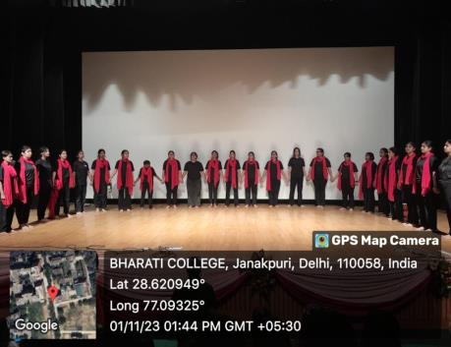
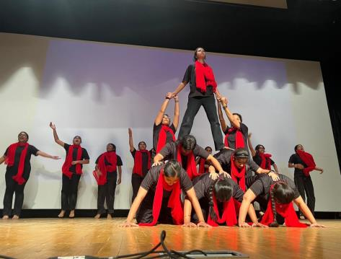
st
6) PERFORMANCE ON FRESHERS’ 2023 [1
November 2023]
Manthan - The Nukkad Natak Society stole the show at Freshers’ 2023 with a
powerful performance focused on women's empowerment. The society took
advantage of the chance to use the entertaining medium of Nukkad Natak to raise
awareness of important topics. Their presentation, a moving story, depicted the
complex path taken by women who aspire to be empowered. They brought attention
to the difficulties women confront and their tenacity through thought-provoking
conversations and powerful scenes. The crowd was enthralled with the emotionally
charged performance, which skilfully combined entertainment with a thought-
provoking social message. It sought to stimulate discussions about female
empowerment and equality. This performance started a conversation and raised
awareness among the Freshers 2023 cohort, establishing the foundation for a group
of people dedicated to social change.

Slide 8
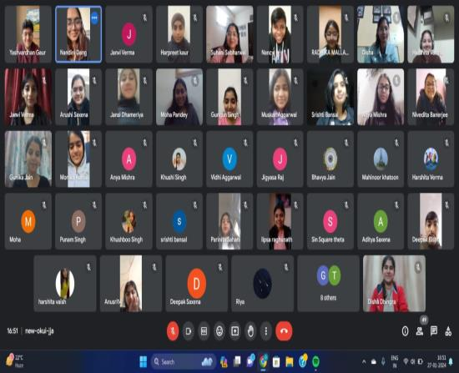
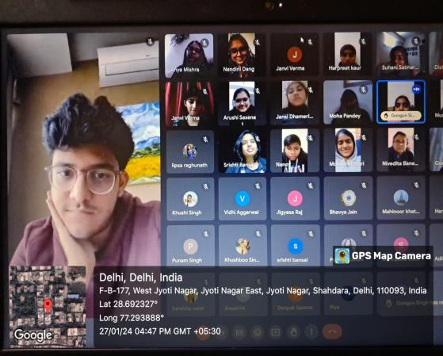
th
7) WEBINAR BY YASHVARDHAN GAUR [27
January 2024]
On January 27, 2024, Manthan-The Nukkad Natak Society held a webinar with the
goal of educating attendees and improving their comprehension of acting with
speaker, Yashvardhan Gaur, the program offered insightful information about the
use of the seven senses in acting and character development. Actors such as
Andrew Scott, Irrfan Khan, and Nawazuddin provided examples that demonstrated
the value of critical thinking, active listening, and observation in acting. President
Suhani Sabharwal conveyed her appreciation for the enlightening encounter while
highlighting the importance of the occasion in enabling attendees
.
The learning
process was further improved by an engaging Q&A session that promoted deeper
investigation of the subjects covered. The goal of the webinar was to demystify
acting by providing participants with useful tools to improve their abilities and self-
assurance, ultimately enabling them to excel in their artistic endeavours.

Slide 9
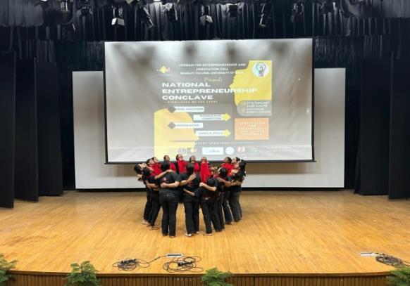
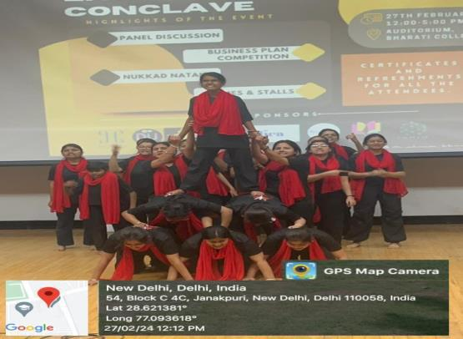
8) PERFORMANCE AT
ENTREPRENEURSHIP
th
CONCLAVE [27
February
2024]
Manthan -The Nukkad Natak Society of Bharati College, gave a remarkable
performance at the Entrepreneurship Conclave. During their performance, they
praised the transforming potential of entrepreneurship and encouraged students to
think about it as a possible career path. They emphasised the value of female
entrepreneurs and the role that entrepreneurship plays in innovation and economic
growth through gripping stories and outstanding performances. The audience
applauded the powerful presentation and responded enthusiastically. Manthan's
accomplishments highlight how crucial it is to support programs that empower
women in business and encourage the upcoming generation of entrepreneurs. Such
compelling performances demonstrate Bharati College's dedication to promoting an
inclusive business ecosystem. The response from the crowd demonstrates how
much of an impact Manthan's act had, encouraging discussions on gender equality
and entrepreneurship. Such initiatives drive positive change, shaping a future where
entrepreneurship flourishes and gender equality prevails.

Slide 10
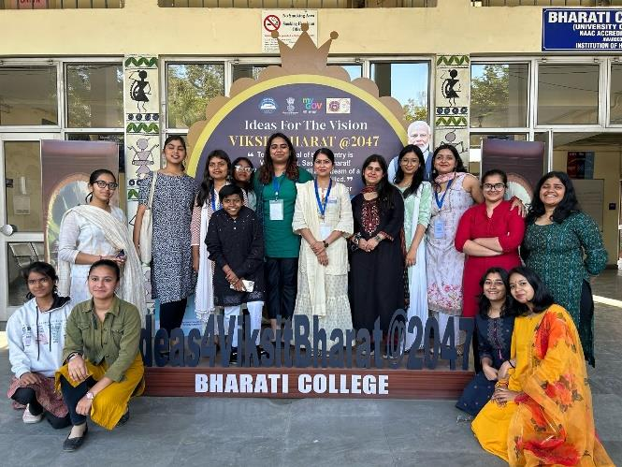
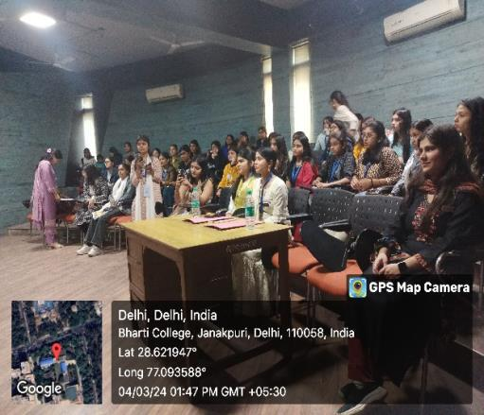
th
9) OPEN MIC COMPETITION [4
March 2024]
The "Viksit Bharat@2047" open mic competition, hosted by Manthan, The Nukkad
Natak Society, in collaboration with Chintan, The Debating Society of Bharati
College, was a resounding success, seamlessly blending vibrant energy with
intellectual discourse. Participants showcased their talents, engaging in thought-
provoking debates that captured the essence of shaping India's future. The
deserving winners were honoured with certificates and cash rewards, symbolizing
their pivotal role in shaping the nation's destiny. This event served as a beacon of
hope, promising a future filled with more enriching projects aimed at fostering growth
and unity. It underscored the power of collaboration in driving societal development
and nurturing a profound sense of community among individuals dedicated to India's
progress.

Slide 11
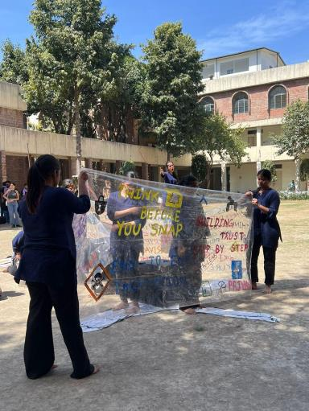
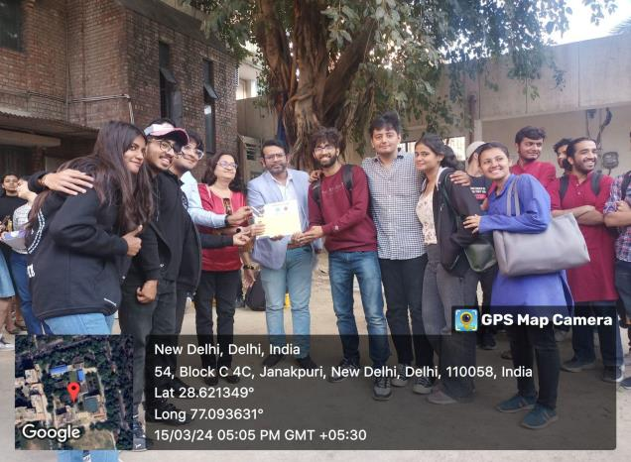
th
10) TAMAASHEBAAZI’24, A STREET PLAY COMPETITION [ 15
March
2024]
In highlight of Bharati College's Annual Cultural Fest - Abhivyakti'24,
Tamaashebaazi'24 left an indelible mark with its showcase of extraordinary talent,
garnering widespread acclaim from all quarters. Renowned theatrical artist Mr. Vipin
Kumar from National School of Drama, graced the occasion as the esteemed judge,
adding prestige to the event. Organized by Manthan - The Nukkad Natak Society,
Tamaashebaazi'24 witnessed participants from various universities, each
showcasing their unique talents in a spirited competition for recognition and lucrative
financial awards. The powerful street plays lit up the ground. The audience was
enthralled as each act unfolded. Through laughter, tears, and moments of awe,
Tamaashebaazi'24 celebrated the boundless potential of artistic expression, leaving
an indelible mark on all who attended. Tamaashebaazi'24 not only showcased the
diverse talents within the college but also fostered a spirit of camaraderie and
collaboration among participants, reinforcing the values of teamwork.

Slide 12
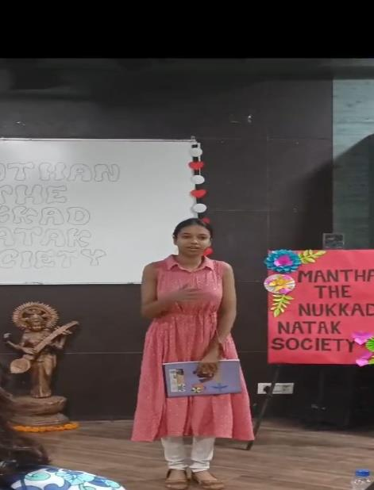
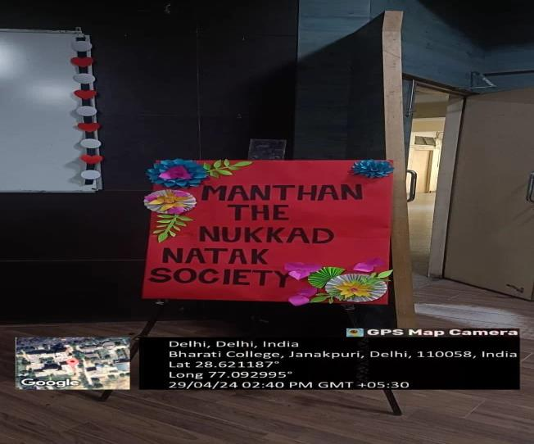
th
11
) MONO – ACT COMPETITION [29
April 2024]
Manthan, the Nukkad Natak Society of Bharati College, hosted a memorable mono-
act competition, guided by the esteemed convenor, Dr. Bindia Trivedi who inspired
everyone with her motivating words and guided everyone for better performance.
Participants showcased their talents, receiving invaluable feedback from seniors,
fostering a deeper understanding of societal issues. The event commenced with
gratitude for the seniors' guidance. Performances addressed diverse social
challenges, followed by transformative feedback sessions enhancing authenticity.
Reflecting on their journey, a sense of camaraderie emerged, emphasized by the
President's heartfelt address. In a touching gesture, seniors were honored for their
support. As the semester concludes, Manthan extends gratitude, epitomizing values
of camaraderie. The event, including a final training session, highlighted the society's
commitment to talent nurturing and social awareness.
.

Slide 13
COLLABORATIONS FOR THE ACADEMIC YEAR
2023-2024
1.MANTHAN X KAVYA
Manthan - The Nukkad Natak Society of Bharati College, and Kavya – the Poetry Society of
Bharati College, embarked on a collaborative initiative aimed at expanding their audiences
and promoting each other's creative endeavours. By exchanging followers and engaging in
mutual support, the two societies not only enhanced their reach but also fostered a culture of
artistic appreciation within the college community. This partnership exemplifies the power of
collaboration in nurturing creativity and strengthening bonds among students, paving the
way for continued synergistic efforts in the future.
2.MANTHAN X DU FEST
Manthan – The Nukkad Natak society of Bharati college, forged a partnership with DU Fest -
a distinguished Instagram platform with more than 25k dedicated followers enthusiastic for
curating updates on the diverse talents and events within Delhi University's vibrant
community. This collaborative effort saw us exchanging followers, with DU Fest generously
promoting our Manthan page while we reciprocated the gesture. This mutual exchange
drastically expanded the audience reach of our page, effectively elevating our visibility and
engagement levels. Furthermore, our collaboration extended to crafting captivating reels,
which served to enhance our collective online presence and facilitate mutual promotion. This
synergistic alliance vividly illustrates the multitude of benefits that collaboration can offer,
showcasing how teamwork can pave the way for increased success and exposure for all
involved stakeholders.
3.MANTHAN X CHINTAN
This collaboration brought together Manthan-Tthe esteemed Nukkad Natak Society, and
Chintan - The revered Debating Society, both pillars of Bharati College's vibrant cultural
landscape. Together, they organized an enlightening open mic competition centred around
the theme 'Viksit Bhara@2047t'. This event aimed not only to educate students about the
envisioned developed state of India by 2047 but also to honour the invaluable contributions
of our freedom fighters.

Slide 14
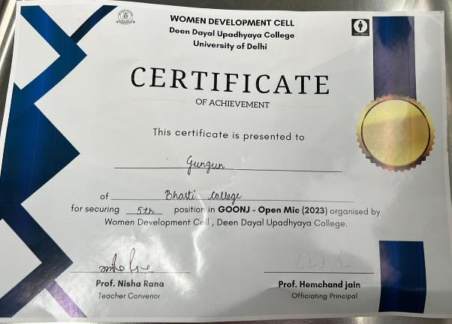
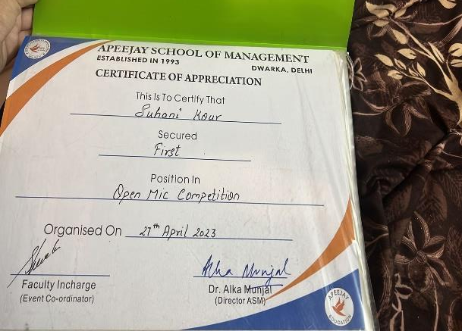
ACHIEVEMENTS
•
Suhani Kour, senior executive member of Manthan, won first prize in
two open mic competitions this year by performing a mono act. The
Apeejay School of Management organized one, while Chintan, the
Debating Society of Bharati College, organized the other.
•
Suhani Sabharwal, the President of Manthan, demonstrated her skills
in live broadcasts on FM Rainbow on Akashvani, All India Radio.
During the Azaadi Ka Amrit Mahotsav celebrations, she was featured
on 102.6 FM Rainbow for a program emphasizing "Youth Icon and
Role Model in Culture" and spoke about the "Impact of Westernization
on Indian Society,” while embracing the power of voice.
•
Nandini Dang, The Vice President of Manthan, bagged second position
in Apeejay School of Management's open mic competitions where she
performed an act on women empowerment.
•
Disha Dhingra, The Secretary of Manthan bagged third position in an
open mic competition organized under the banner of Viksit
Bharat@2047where she performed an act on Freedom Fighters.
•
Gungun Singh, senior executive of Manthan bagged second position in
an open mic hosted by Viksit Bharat where she performed an act
promoting cultural inclusivity.

Slide 15
SOCIAL MEDIA HANDLES OF MANTHAN
https://www.instagram.com/p/CvzwNokRwJB/?utm_source=ig_web_copy_link
https://www.instagram.com/p/Cwu-8FLtKH9/?utm_source=ig_web_copy_link
https://www.instagram.com/reel/Cw0dIltxO6u/?utm_source=ig_web_copy_link
https://www.instagram.com/reel/CxzmnqVRAMX/?utm_source=ig_web_copy_link
https://www.instagram.com/reel/CzDiZ7YxGkK/?utm_source=ig_web_copy_link
https://www.instagram.com/reel/CzNs0gFCsX_/?utm_source=ig_web_copy_link
https://www.instagram.com/reel/C2iJLUQSBV9/?utm_source=ig_web_copy_link
https://www.instagram.com/reel/C38IXlAy75o/?utm_source=ig_web_copy_link
https://www.instagram.com/p/C35kQC0SsRe/?utm_source=ig_web_copy_link
https://www.instagram.com/p/C4BUnJ2y2JV/?utm_source=ig_web_copy_link
https://www.instagram.com/reel/C6qvXRTyk2d/?igsh=M2NsNHRsZHVkeGVh
FOR MORE DETAILS CONTACT:
manthannukkadnataksociety@gmail.com
https://www.instagram.com/manthannukkadnataksoc?igsh=cGc0cjhzeXdueXZ4

Slide 16
ANNUAL ATTENDANCE REPORT
MEMBERS OF SOCIETY
SEMESTER (1,3,5)
ATTENDANCE SLOT
Suhani Sabharwal
5
S3
Nandini Dang
3
S3
B Lipsa Raghunath
5
S3
Disha Dhingra
3
S3
Disha
5
S3
Srishti Bansal
5
S3
Anusri Ramavath
3
S1
Arushi Saxena
3
S1
Bhavya Jain
1
S2
Gungun Singh
3
S2
Gunika Jain
1
S2
Harpreet Kaur
5
S2
Harshita Verma
1
S1
Jansi
1
S1
Janvi Verma
5
S3
Monika Kumari
1
S1
Muskan Aggarwal
1
S2
Nivedita Banerjee
5
S1
Priya Singh
1
S2
Radhika Mallaha
3
S2
Suhani Kour
3
S2
Nancy
5
S3
Anya Mishra
1
S1
Parinita Sahani
3
S1

Slide 17
MEMBERS OF SOCIETY
SEMESTER (2,4,6)
ATTENDANCE SLOT
Suhani Sabharwal
6
S3
Nandini Dang
4
S3
B Lipsa Raghunath
6
S3
Disha Dhingra
4
S3
Disha
6
S3
Srishti Bansal
6
S3
Anusri Ramavath
4
S3
Arushi Saxena
4
S1
Bhavya Jain
2
S3
Gungun Singh
4
S2
Gunika Jain
2
S3
Harpreet Kaur
4
S3
Harshita Verma
2
S3
Jansi
2
S3
Janvi Verma
6
S2
Monika Kumari
2
S3
Muskan Aggarwal
2
S3
Nivedita Banerjee
6
S3
Priya Singh
2
S3
Radhika Mallaha
4
S3
Suhani Kour
4
S2
Nancy
6
S3
Anya Mishra
2
S2
Parinita Sahani
4
S1

Slide 18
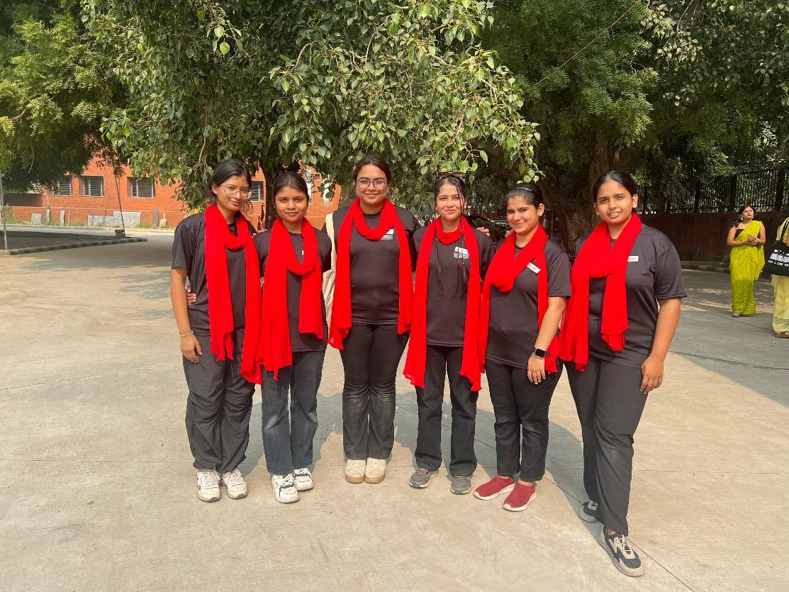
TEAM
(From L to R, Disha, B Lipsa Raghunath, Nandini Dang, Suhani Sabharwal, Disha
Dhingra, Srishti Bansal)
CORE MEMBERS
Suhani Sabharwal [President]
Nandini Dang [Vice President]
B Lipsa Raghunath [Treasurer]
Disha Dhingra [Secretary]
TEAM HEADS
Disha [Public Relations Head]
Srishti Bansal [Scriptwriter]
SUPER SENIOR EXECUTIVES
•
Nivedita Banerjee
•
Janvi Verma
•
Nancy

Slide 19
SENIOR EXECUTIVES
•
Parinita Sahani
•
Arushi Saxena
•
Suhani Kour
•
Harpreet Kaur
•
Radhika Mallaha
•
Gungun Singh
•
Anusri Ramavath
EXECUTIVES
•
Bhavya Jain
•
Muskan Aggarwal
•
Gunika Jain
•
Harshita Verma
•
Priya Singh
•
Jansi
•
Monika Kumari
•
Anya Mishra
In the academic year,2023-24, Manthan-The Nukkad Natak society demonstrated
remarkable dedication, contributing to the performance of impactful street plays and
a promotional act. Proud of our achievements, we eagerly anticipate future
opportunities and challenges. With a commitment to excellence, we aim to gives
more dynamic street play performances, fostering societal awareness and artistic
expression. The upcoming year holds promise as we continue to pursue our goals
and polish our acting skills with unrelenting resolve and dedication within our
society's vibrant community.
Convenor: Dr. Bindia Trivedi
President: Suhani Sabharwal
Vice President: Nandini Dang

