Slide 1
Loksamvad Event Report
College: Bharati College, University of Delhi Date of Activity: 21 October 2024- 15 April 2025
Department/Society: Loksamvad- Department of Political Science
Introduction
The Department of Political Science, Loksamvad, 2024-25 featured a diverse range of activities that showcased the talents and enthusiasm of the participants. The event was organized by the the Loksamvad students union 2024-2025 under the guidance of Teachers in charge Dr Anuranjita Wadhwa and was held at Bharati College.
Events and Activities
Interactive Session on "Remembering the Horrors of Partition of India 1947”: 14th August 2024
Vimarsh, the academic cell of Loksamvad, Department of Political Science, Bharati College, University of Delhi, organized an interactive session on "Remembering the Horrors of Partition of India (1947)" on August 14, 2024, at room no 101 of Bharati College, University of Delhi.
Investiture Ceremony: 22 October 2024
The investiture ceremony was held on 22nd October 2024 with renowned Radio Jockey (RJ) Kavneet Kaur Sindhu gracing the occasion as the chief guest. The ceremony marked the official induction of the new student council members, who were sworn in with great fanfare.
On-Spot Debate : Role of media on democracy : 14 November 2024
The on-spot debate was a thrilling event held on 14th November 2024 that saw students engaging in a lively discussion on the role of media in democracy. The debate was a great way to encourage critical thinking and public speaking skills among the students.
Round Table Discussion on Constitution Day : 26th November 2025
On the occasion of Constitution Day on 26th November 2024 a round table discussion was organized to discuss the significance of the constitution and its relevance in modern times. The discussion was a great way to promote awareness and understanding of the constitution among the students.
Informative Monday Series : 11 November 2024- 7th April 2025
The informative Monday series has been a regular feature of the Loksamvad on its social media platform on various topics. The sessions have been a great way to keep the students informed and updated on current events and trends.

Slide 2
Gandhi Martyr Day : 30th January 2025
Loksamvad,the Department of Political Science, in collaboration with the Gandhi Study Circle, organized a poignant and inspiring event to commemorate Gandhi Martyr's Day. The event brought together students and faculty from various departments and years to pay tribute to the Father of the Nation, Mahatma Gandhi.
Loksamvad Fest: POLIS 25 (11 February 2025)
The Department of Political Science, Loksamvad, hosted its annual academic fest, POLIS 25, on February 11, 2025. The event drew students from across Delhi University colleges, besides Bharati College. The competitions planned for the participants included:
Fitoor-e-Chunav (caricature competition on the theme of elections)
Technopolis Competition (essay and poem writing on 'Role of AI in Politics)
Monologue Competition (Who Am I as a Political Thinker)
Open Mic Competition (diverse talents, including dancing and singing were showcased)
Seminar on AI: Pain or Panacea in the Age of Climate Change - Policies and Implications Session. : 13 February 2025
A seminar on AI: Pain or Panacea in the Age of Climate Change - Policies and Implications Session was held on 13 February 2025 in Bharati college with Dr. Richa Kumari, Assistant Professor of IIM Delhi, as the speaker. The seminar provided students with insights into the role of AI in politics.
Kursi competition : 25th February 2025
The KURSI Competition was a resounding success, blending education with entertainment to provide a holistic learning experience. By simulating real-world political scenarios, the event allowed students to delve into the complexities of governance and leadership. The collaborative effort between Loksamvad and Zenwood Games resulted in an innovative platform that not only engaged participants but also enriched their understanding of political systems.
Parliament Visit : 28th February 2025
16 students of the political science department visited Parliament on 28th February 2025 to attend a seminar event, which provided them with in-depth knowledge on the Indian Constitution through sessions with renowned figures and visits to rajya sabha and lok sabha.
Quiz and Essay Competition : 26th March 2025

Slide 3
A quiz and essay competition was organized in collaboration with Vision IAS on 26th March 2025 in Bharati college which tested the students' knowledge and critical thinking skills. The event was a resounding success, with participants enthusiastically engaging with the challenges.
Seminar on Borders and Boundaries: Displacement, Identity, and Resettlement : 15 April 2025
The seminar, "Borders and Boundaries: Displacement, Identity, and Resettlement," successfully provided a platform for introspection and discussion on the complexities of displacement, identity, and resettlement in the context of India's partition. Organized by Loksamvad, Department of Political Science, and Department of Punjabi, Bharati College, University of Delhi, the event brought together esteemed scholars, researchers, and students to engage in thought-provoking discussions and reflections. Held on April 15, 2025, from 10 am to 3 pm in the auditorium of Bharati College, the seminar featured a keynote address, panel discussion, documentary screening, and a poignant play, "Goonjti Khamoshi," performed by the Manthan Society of Bharati College. Through these various components, the seminar reinforced the importance of remembering and learning from the past to build a more inclusive and compassionate future, ultimately providing a nuanced understanding of the partition's impact on displacement, identity, and resettlement.
Conclusion
The Loksamvad Event was a memorable experience, reflecting the department's commitment to promoting academic excellence, social awareness, and creativity among students. The event was a testament to the students' talents and enthusiasm, and it provided a platform for them to showcase their skills and knowledge.

Slide 4
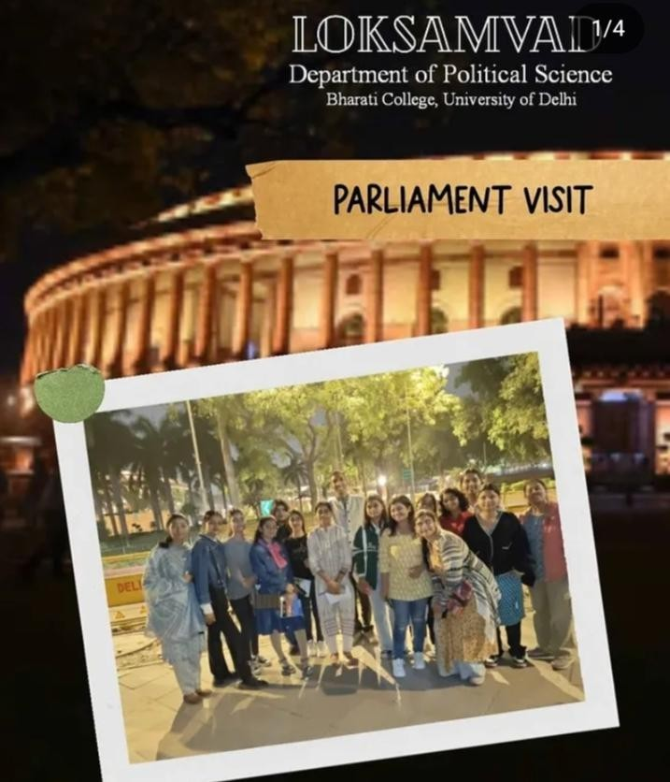
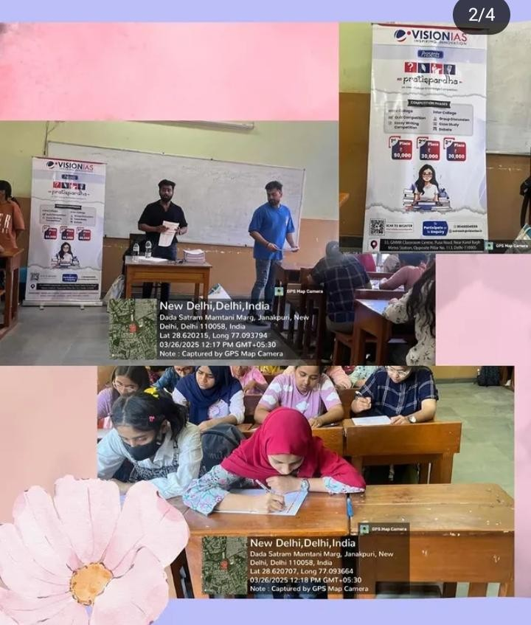
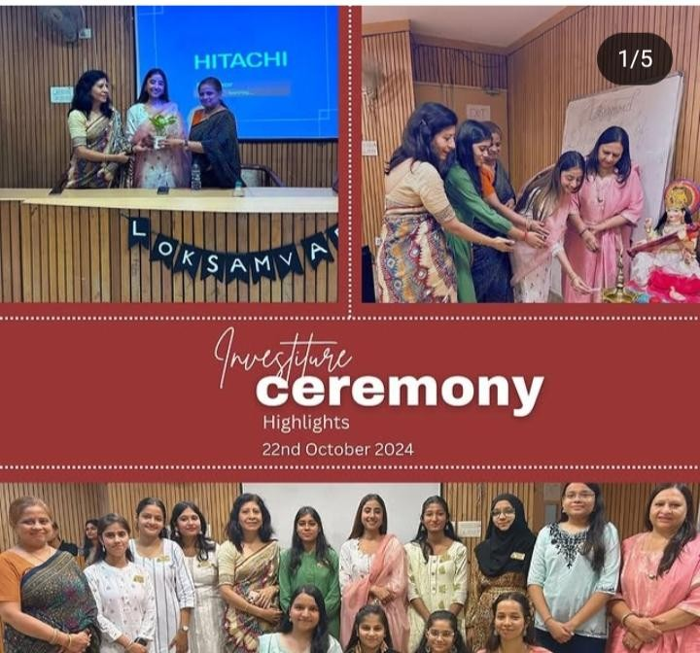
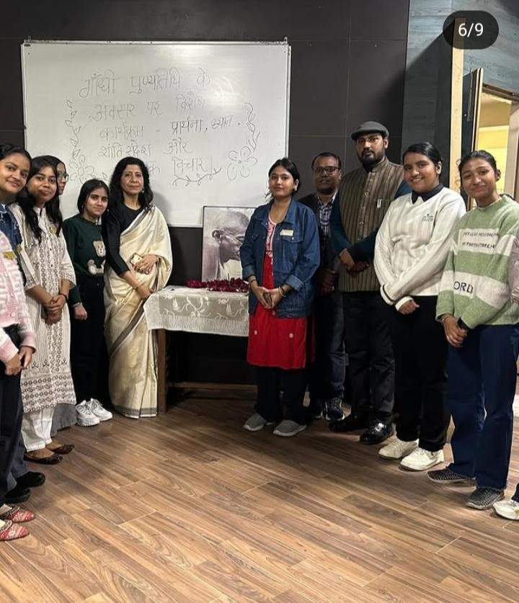
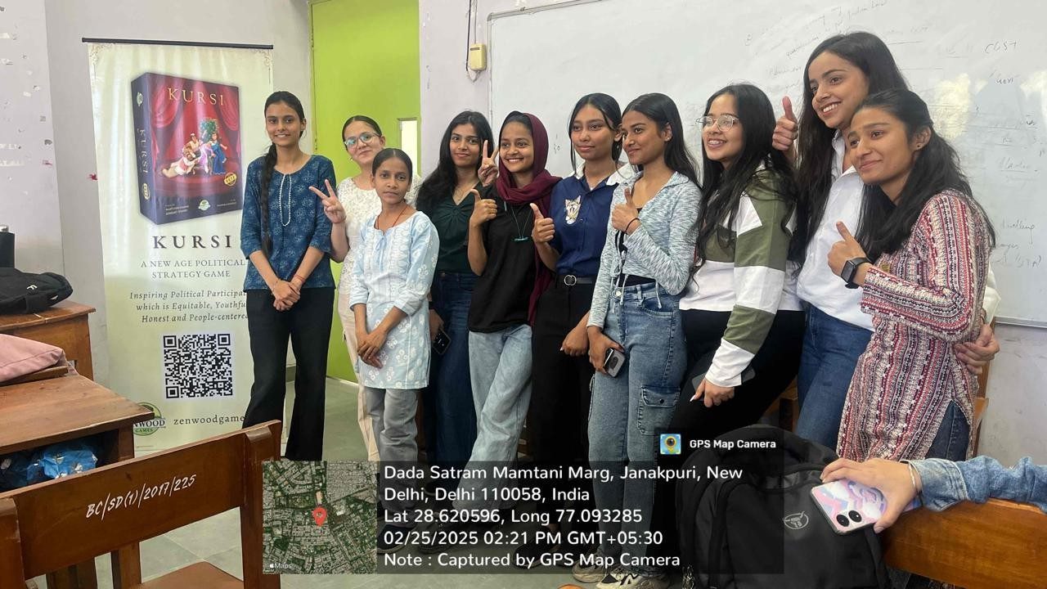

Slide 5
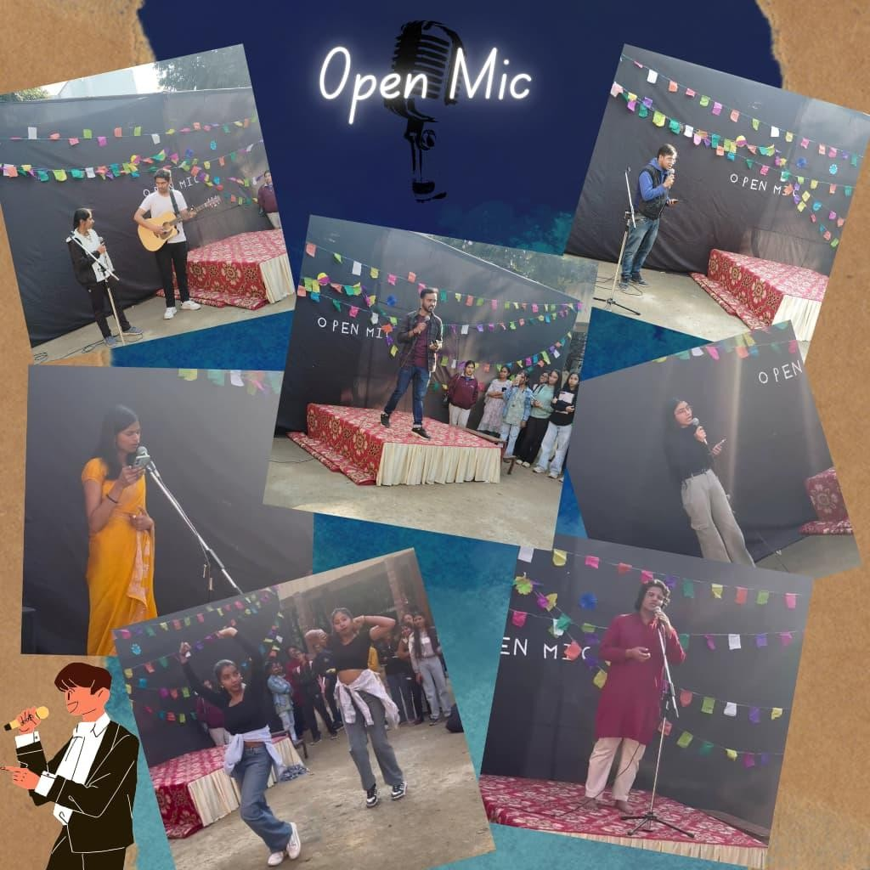
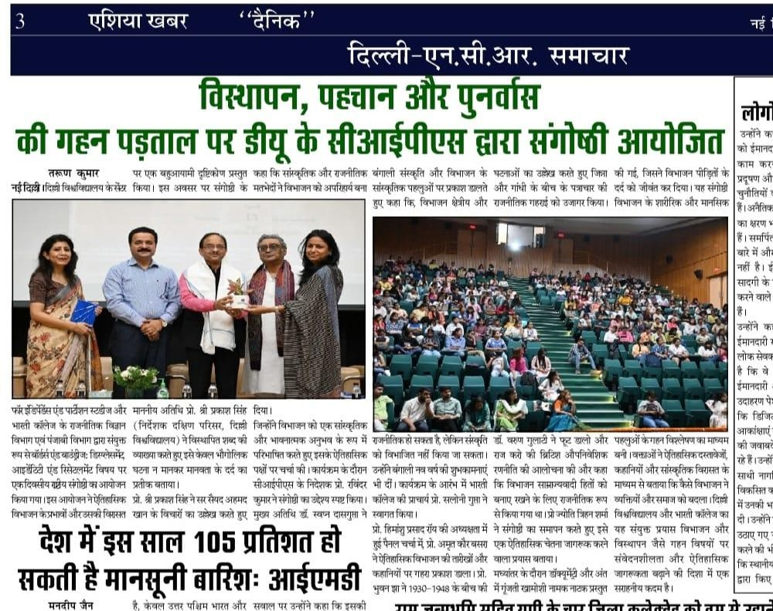

Slide 6
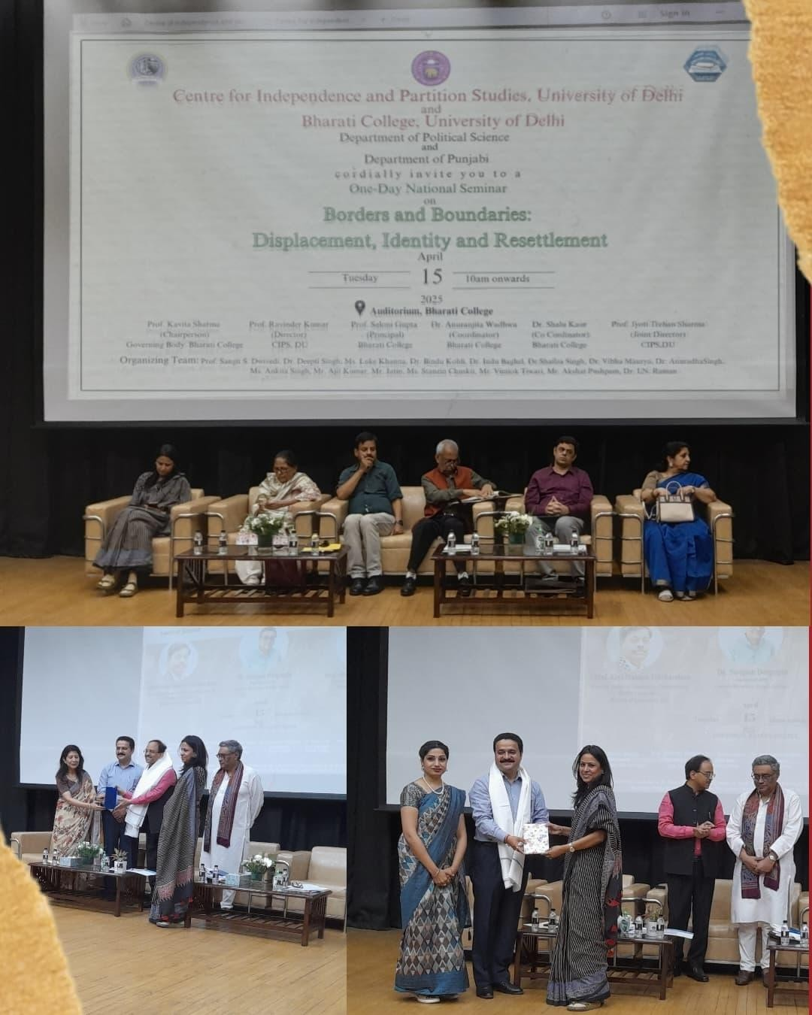

Slide 7
