Slide 1

Socity Details
Society Name
: Kudiya di Phulkari
Email
: kudiyadiphulkari@bharati.du.ac.in
Convenor
: Dr. Shalu Kaur ()
Co-Convenor
: Dr. Bhawna Shivan ()
Type
: ECA
Website
: departmentpunjabi11@gmail.com
Facebook Profile
: https://m.facebook.com/Phulkari_society- 1948682758718534/?ref=bookmarks
Website
: https://instagram.com/phulkari_kudiyaandi?igshid=hcb79cg1nnm7
Linkedin Profile
: View
Vision
: Our aim is to prepare students for competition in the life to come with additional benefits of being connected with their heritage. Our Vision is to make the society well known in the field of Art, Literature and Culture not only at state level but also at National and International fore. The idea is to bring fame and laurels for our beloved college along with Recognition to participating students.
Mission
: The students who join society will get exposed at college as well as University level and they will be able to explore their hidden talent. it is but natural these extracurricular activities will shape their personality in a noble way.
Objectives
: Our society is aiming to infuse Punjabi culture values to the students with training in Punjabi Folk Dance like Bhangra, Giddha, Sammi etc and Folk Music. In addition the students are prepare to compete in Poetry, Painting, Declamation, Debate, Gurbani shabad etc organized by different colleges of University of Delhi.
Activites
: Training in Punjabi Folk Dance like Bhangra, Giddha, Sammi etc and Folk Music. In addition the students are prepare to compete in Poetry, Painting, Declamation, Debate, Gurbani shabad etc organized by different colleges of University of Delhi.
Outcomes
: To imbibe social values in to students to excel in life through readings of great masters and philosophers. To prepare students for job opportunities in different fields related to Punjabi language, literature and culture.
Event List
1. Abhivyakti Annual College Fest
2. Guru Nanak Birthday Celebration

Slide 2
Events Details : 1
Abhivyakti Annual College Fest
Event Name:
Society Name:
Kudiya di Phulkari
Start Date:
01/04/2026
End Date:
02/04/2026
Type:
Competition
Level:
Inter College
Duration:
2 days
Venue:
College Sports Ground
Other Venue:
Bharati College
No Of Participants :
160
Coordinator :
Dr. Shalu Kaur
Description:
Abhivyakti Annual College Fest 2026
Guest Person:
Mr. Sukhwinder Singh
Colleges:
University of Delhi and IP University
Sponsors :
Bharati College Student Union
Participants:
160
Social Media:
View
Marketing Poster:
View
Summary Report:
View
Attendance Sheet:
View
Student Feedback:
View
Guest Resume:
View
Marketing Poster :

Slide 3

Event Media :

Slide 4
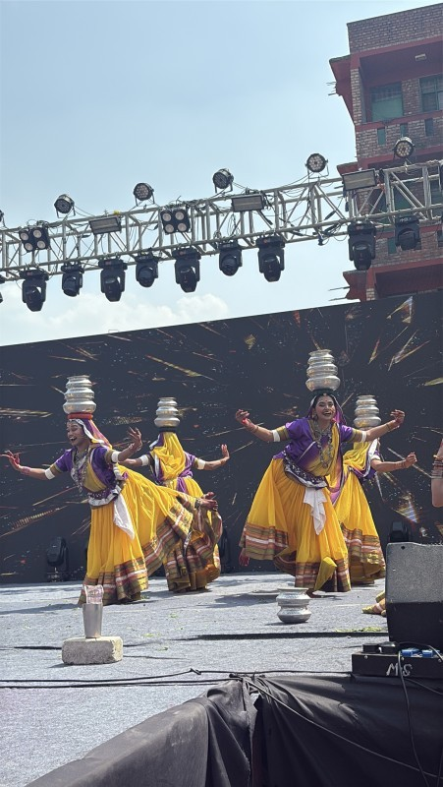
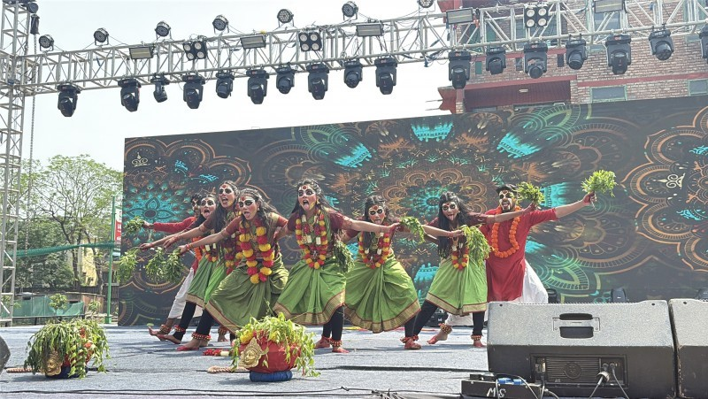
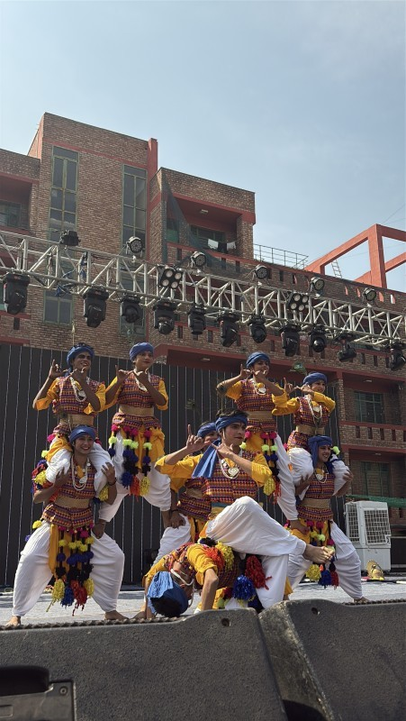
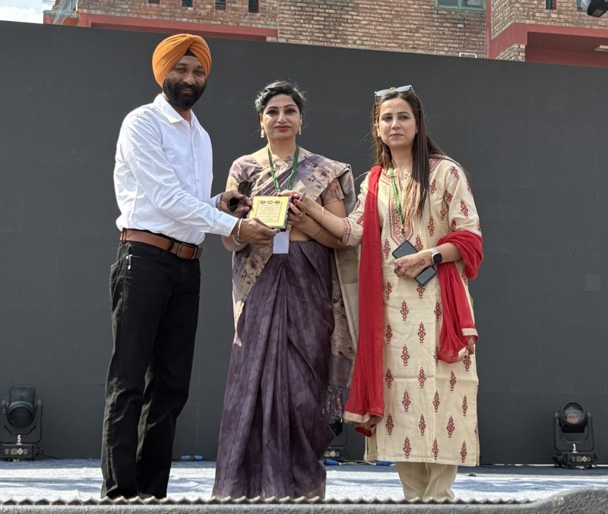
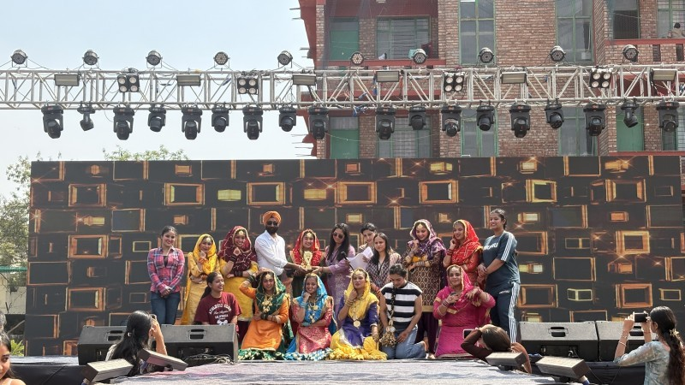
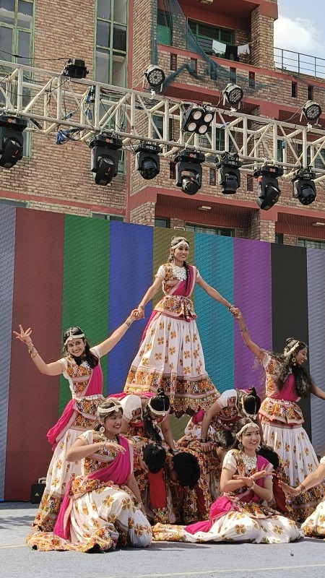
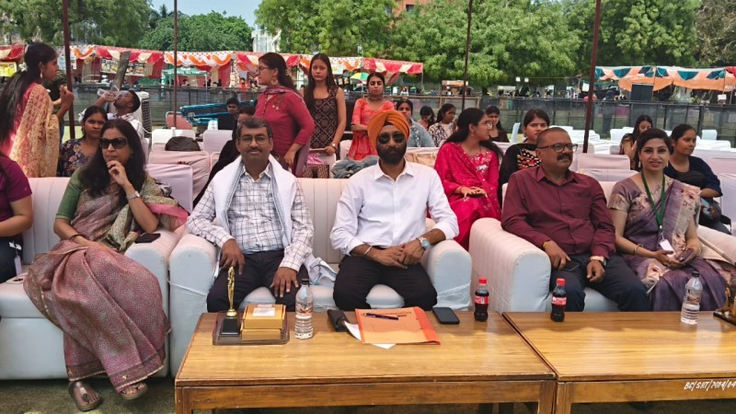

Slide 5
Events Details : 2
Guru Nanak Birthday Celebration
Event Name:
Society Name:
Kudiya di Phulkari
Start Date:
04/11/2025
End Date:
04/11/2025
Type:
Social Initiative
Level:
Intra College
Duration:
1 days
Venue:
Theatre Room
Other Venue:
Bharati College
No Of Participants :
70
Coordinator :
Dr. Shalu Kaur
Description:
celebration of Guru Nanak Dev ji's birthday.
Guest Person:
Nil
Colleges:
Nil
Sponsors :
Nil
Participants:
70
Social Media:
View
Marketing Poster:
View
Summary Report:
View
Attendance Sheet:
View
Student Feedback:
View
Guest Resume:
View
Marketing Poster :

Slide 6
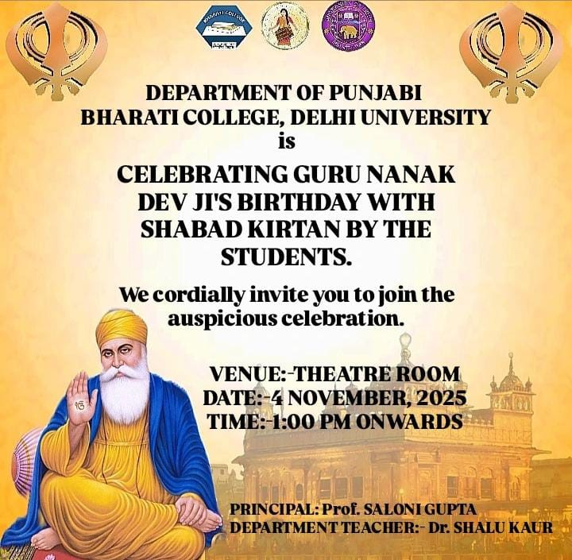
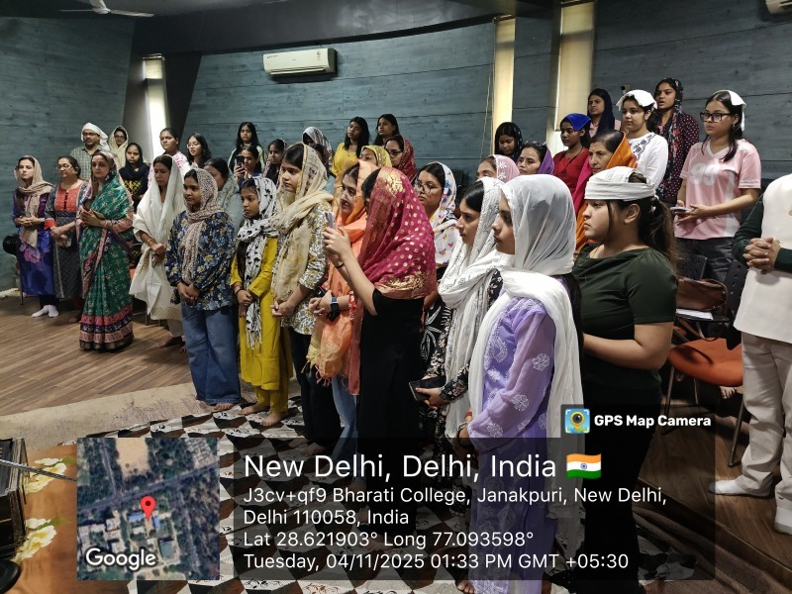
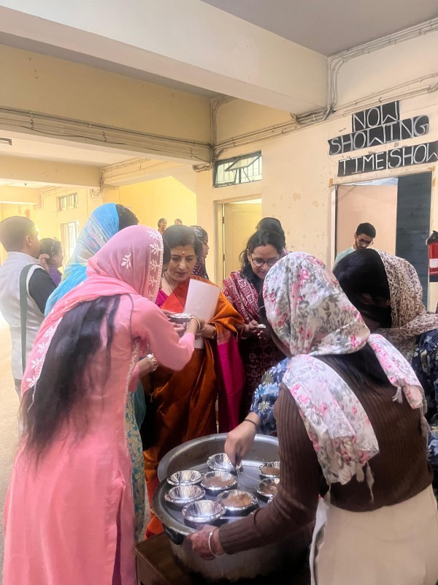
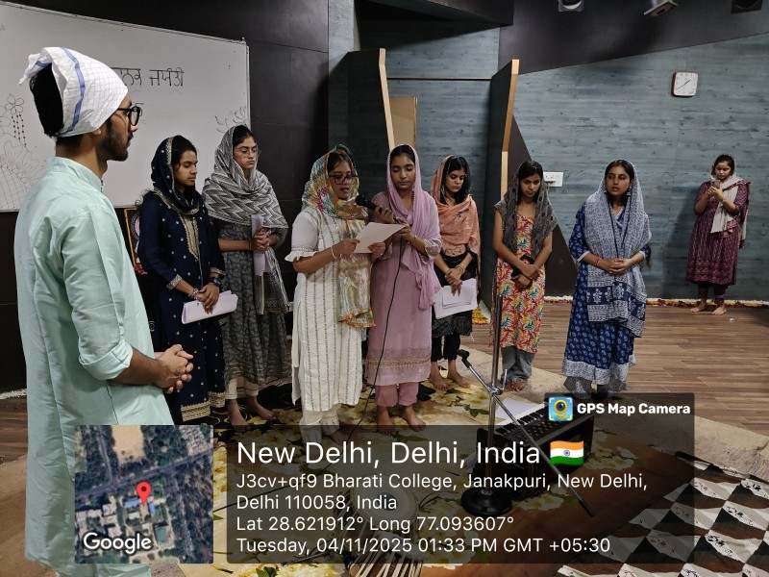
Event Media :

